Slide 1
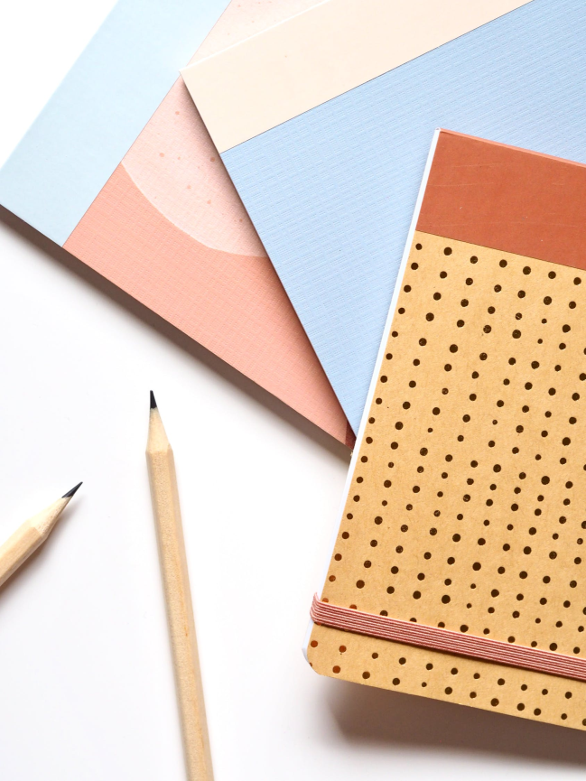
Keeping a Writer’s Notebook
MaGPiE Creative Skills for Teachers CPD
4 February 2021

Slide 2
The notebook is a seed bed, a treasure chest, a playground, a menagerie, a cabinet of curiosities
The notebook is just for you. You can write in privacy and secrecy and discover the multitude of strange and wonderful stories that come from your own extraordinary imagination. You may discover a story that you really do want to organise, to share with others, to make public. If you do, that’s wonderful. That’s how I work. I experiment in my notebook, then go on to create something I want to make public. But I keep on scribbling and doodling. The beautiful messy notebook is at the heart of all my work. Most of it is never seen by anyone but myself.
David Almond (from Dare to Write?)

Slide 3
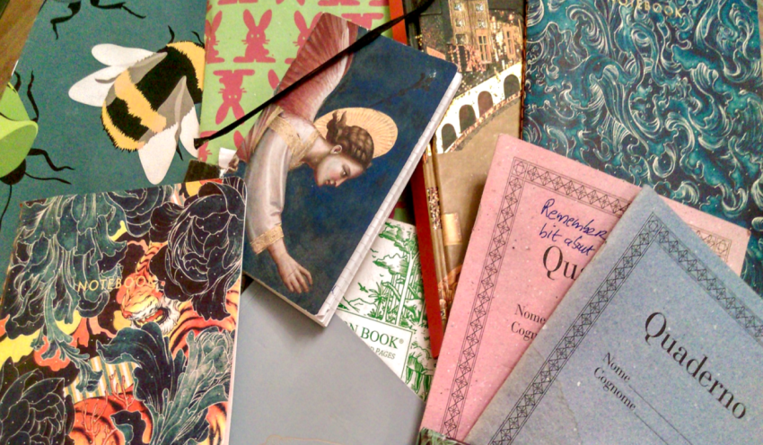
There are no rules about what it should contain
Recipes have made their way onto the margins, measurements of flour and sugar. Elsewhere, I see that I’ve taken notes on a too-good-to-resist conversation overheard at a café, a very promising and surreal row which included the rather wonderful line: “If you don’t get your ears done soon, I’m going to have to start writing you letters.”
Danielle McLaughlin (https://lithub.com/what-really-goes-on-in-a-writers-notebook)

Slide 4
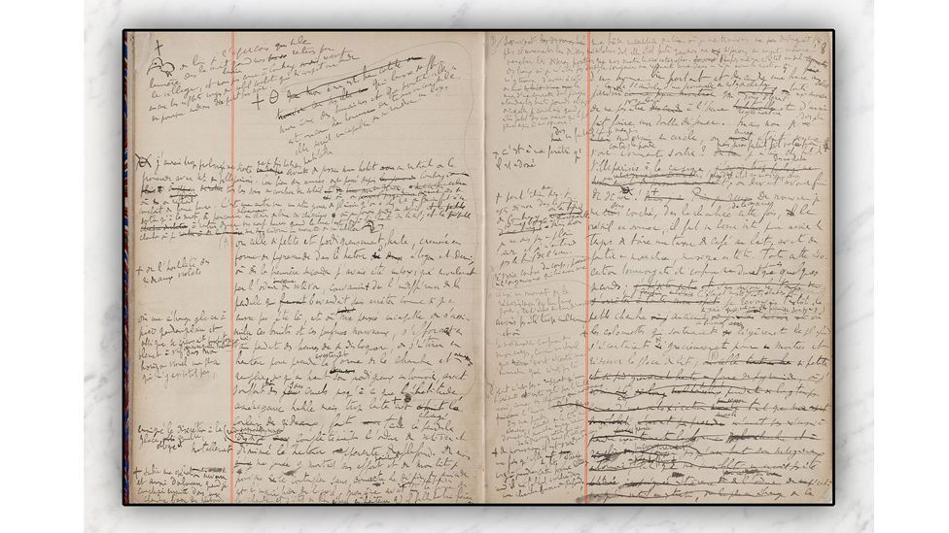
The notebooks in which Proust hand-wrote In Search of Lost Time (Credit: SP Books) (Surprising secrets of writers first book drafts)

Slide 5
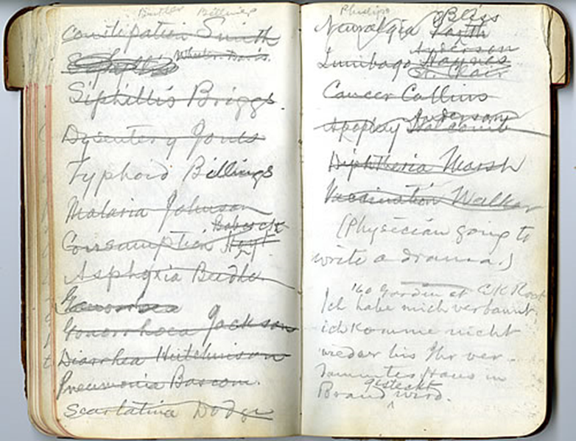
Mark Twain carried a notebook to record notes, addresses, personal errands, and ideas. In 1884, he filled seven pages with a list of potential characters. (https://bancroft.berkeley.edu/Exhibits/mtatplay/literarymischief/.html)

Slide 6
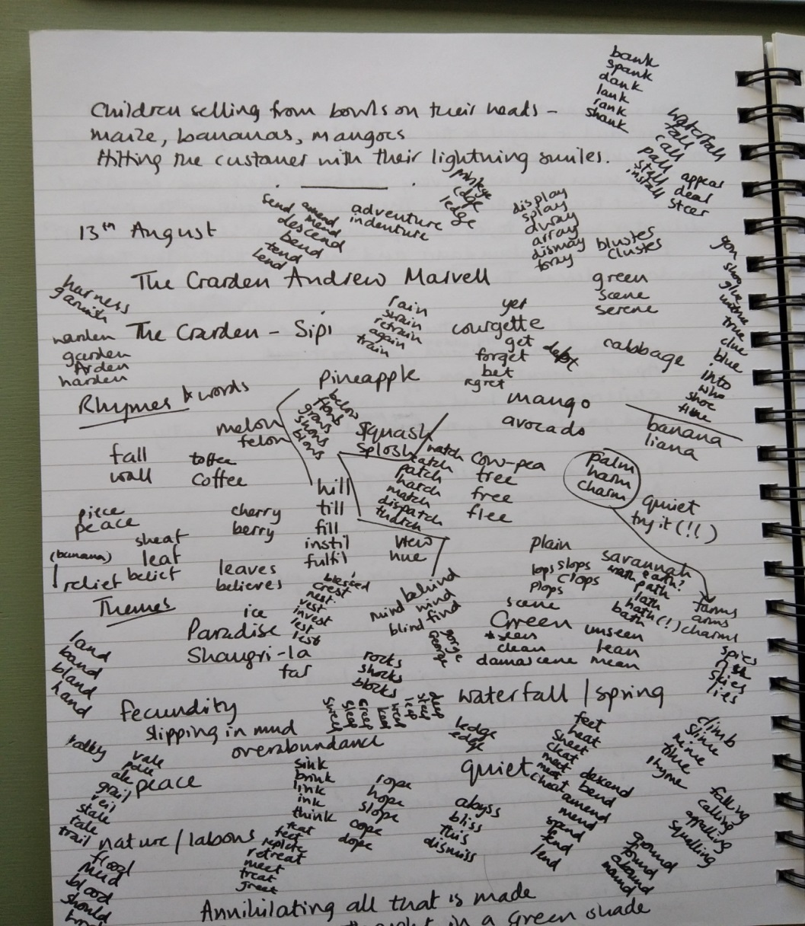
‘I was writing quite a long rhyming poem about a place I went to in Uganda in 2019. This is a page of words I wanted to use and any rhymes I could think of – lots of these ended up in the final poem, and lots didn’t. I kept adding to the page every time I worked on the poem.’
Hilary Elder
(Hilary Elder)

Slide 7
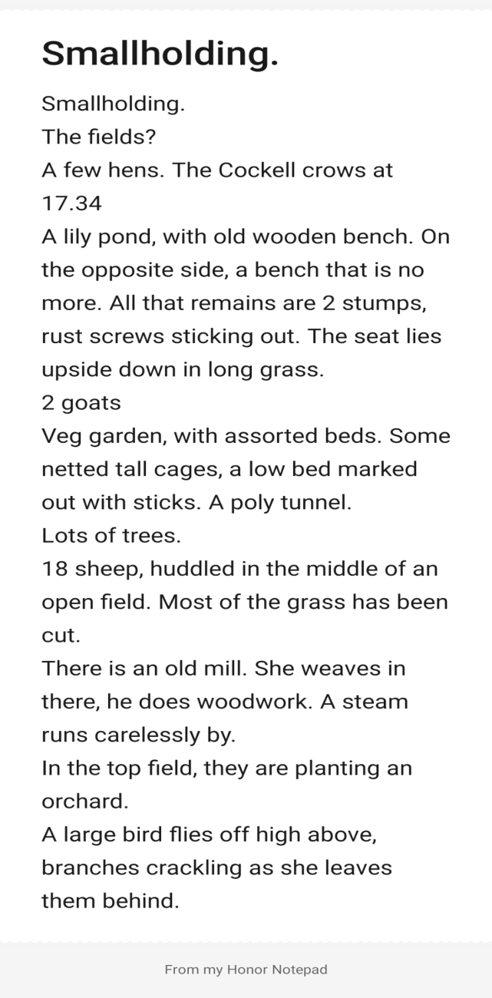
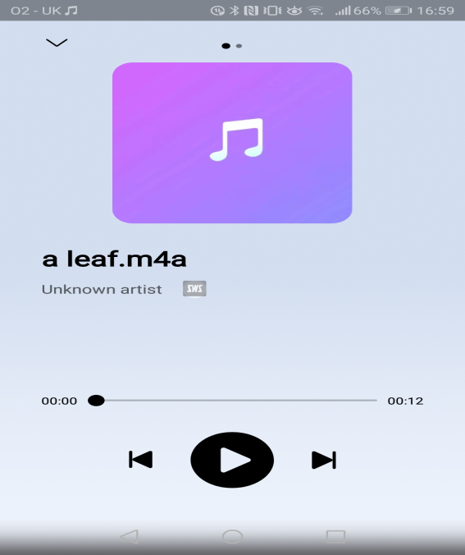
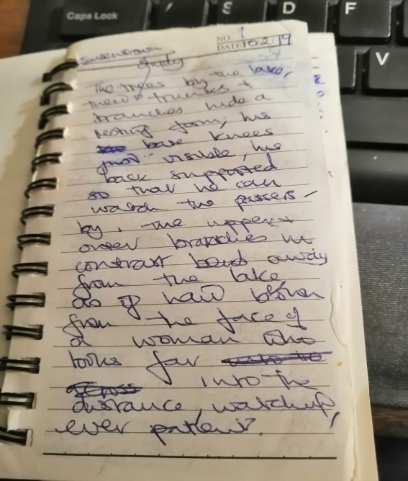
Bonnie Meekums uses the notepad and voice recorder on her phone to make notes when she’s out walking, as well as a traditional notebook.
(Bonnie Meekums)

Slide 8
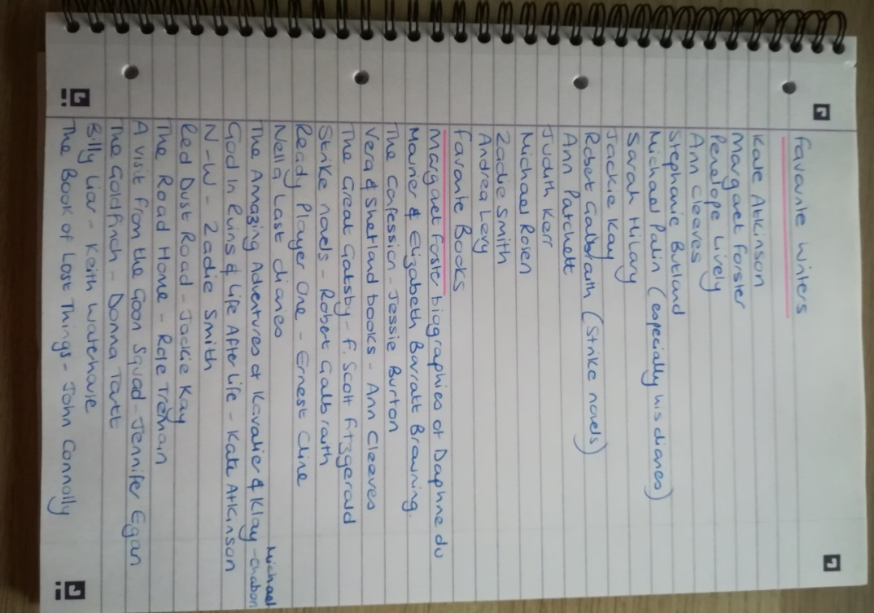
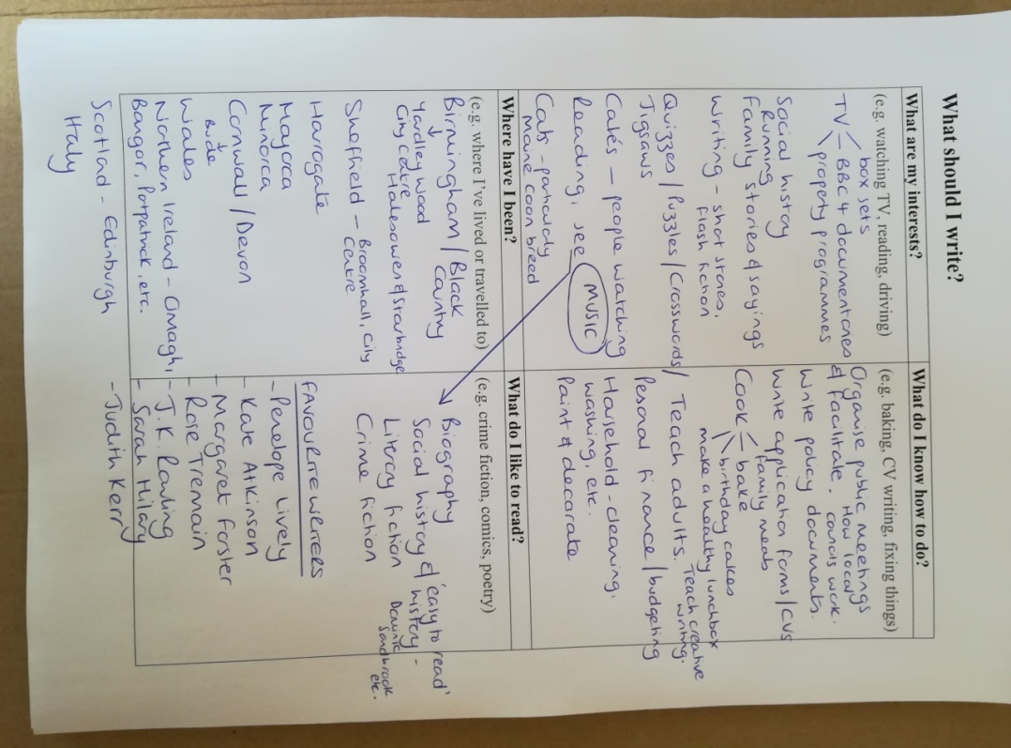
From my notebooks. Exploring and listing interests/experiences to use in my writing.

Slide 9
Notebook Writing Prompts
‘I focus on offering lots of choice within a set structure. I also try to make writing seem messy and doodle-y, and fun.’ (writer response to Paper Nations Call for Evidence - NAWE Writing in Education, Issue 76)
Don’t use a prompt. Spend time with your notebook without plans or instructions.
Write ‘I remember…’ in your notebook. Keep writing. You could also use a theme for this, e.g. ‘What I remember about the sea is…’
Play music. Doodle or draw or write while you listen.
Write lists. Of favourite things. Places you’ve been or would like to go. Character names. Interesting words and quotes. Paste in real life objects (leaves, tickets, photos, etc.).
Dedicate a page for doodles and sketching.
Take your notebook on a field trip. To your back garden or the playground. To a museum. Write about what you see there.
Choose a colour and go for a walk with your notebook. Write down everything you see of that colour. Or note everything you hear or smell.

Slide 10
Notebook Writing Prompts
Use to record experiences and things you notice. Interesting snippets of conversation. How it feels to wake up on Christmas morning. Observe a pet and write a detailed description of them.
Encourage writing for enjoyment and to release and explore feelings. Use to reflect and be mindful. Record what makes you happy and what you appreciate.
Use as a diary or journal (see Bernadette Mayer’s list of journal writing ideas).
Write morning pages. First thing in the morning, write three pages of anything that comes into your mind (this is a concept from writer, Julia Cameron).
Meditate then free write (write without stopping or correcting your work) for five minutes.
Draw your family tree or timeline of significant events in your life. Or invent a character and do this for them.
Watch a film or TV programme. Then write something inspired by it.

Slide 11
Writers notebooks in the classroom
Sends a message: You are a writer and your ideas are important.
‘[the project] was about building the young people’s confidence about writing and for them to feel like writers. It was important to give them an opportunity to write about what interested them, to allow them to choose their subject.’ (Stella Pakeman - teacher involved in Paper Nations Writers in Schools project quoted in NAWE Writing in Education, Issue 76)
Provides an opportunity to take risks with no pressure to get things right. Students of all abilities have time to find their writing confidence.
‘To write well – or undertake any creative endeavour – means to take risks, to set out with only some idea of your ‘map’: to create, recreate, un-create, and co-create, to have ideas, inklings, hunches, inspirations: and to do experiments with them, learning as you go.’ (Caleb Parkin, NAWE Writing in Education, Issue 72)

Slide 12
Writers notebooks in the classroom
Offers freedom to choose how to express yourself.
It doesn’t need to be full of writing and it doesn’t need to be a book.
Establishes a regular writing routine and habit of paying attention. The Free Writing Friday campaign encourages teachers to set aside time for students to write in notebooks every Friday.
Replicates and reveals the process of writers.
‘Insights into the writing life help to open a door in the mind for emergent writers of any age and encourage them to think not just about their creative habits but also where they might take them in the future. Most importantly, hearing that working writers still carry their notebooks, still experiment, still question their work, still re-draft and re-draft, is reassuring.’ (Paper Nations Benchmark Consultation - NAWE Writing in Education, Issue 76)

Slide 13
Writer’s notebooks in the classroom
Make it special.
Use different notebooks to those normally used in school. Allow students to decorate and personalise the covers. Have a ceremony to formally present notebooks (see Creating Classroom Environments).
Write with your students.
‘Writing with the students creates a more even playing field. When I make a mistake or am not sure of something, or am trying something out, I let them know. I think that they find that reassuring. Writing with students also inspires them.’ (teacher/writer response to Paper Nations’ Call for Evidence - NAWE Writing in Education, Issue 76)
Explain that a notebook is a place to collect ideas and things.
‘If teachers stress the notebook as a diary to vent and pour out feelings, well, some boys might recoil from that idea. I have had better luck describing the notebook as a place to collect stuff: facts, stats, quips, jokes, rock lyrics, artefacts, drawings. Many boys (as well as girls) are collectors and seem to resonate with the notebook as a kind of ‘shoebox’ for collecting.’ (Ralph Fletcher)

Slide 14
Further Reading
Cressida_Cowell_Free_Writing_Friday_FAQ_v1.pdf (literacytrust.org.uk)
Get a Notebook - Dare to Write? Library prompt
David Almond on his creative process from notebook to novel - YouTube
2016-18 - Paper Nations
https://www.teachstarter.com/us/blog/how-to-get-kids-writing-writers-notebook-us/
https://www.readingrockets.org/article/mary-amato-s-tips-keeping-writer-s-notebook
https://www.teachstarter.com/us/blog/how-to-get-kids-writing-writers-notebook-us/
https://twowritingteachers.org/category/writers-notebook/
https://motivatetolearn.blogspot.com/2013/01/a-writers-notebook-truly-wonderful-thing.html
Writers in Schools :: National Association of Writers in Education :: (nawe.co.uk)
Teachers as Writers :: National Association of Writers in Education :: (nawe.co.uk)
For examples of writers notebooks see Sharing Our Notebooks (amylv.com) and https://blog.pencils.com/famous-notebook-users/

