Slide 1
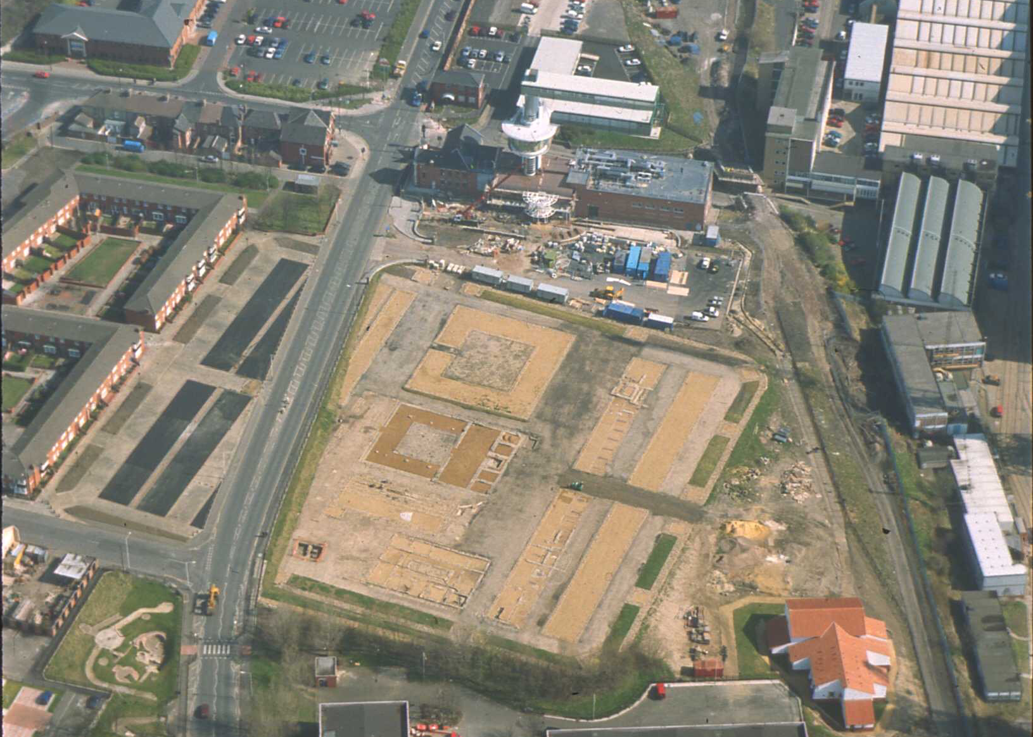
Notes:
An aerial view of Segedunum Fort

Slide 2
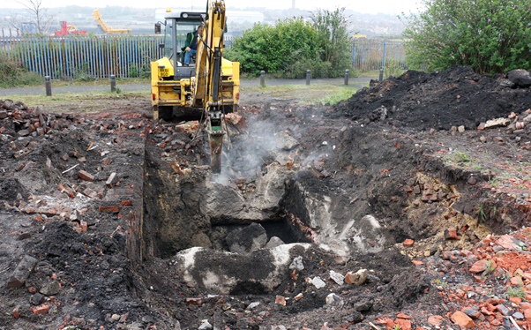
Notes:
Excavation of the original Roman baths at Wallsend.

Slide 3
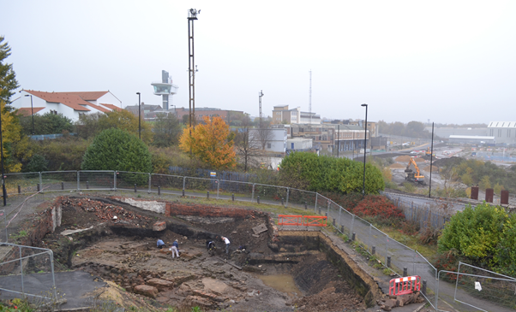
Notes:
The excavated Roman baths at Wallsend, with the replica bath house in the background.

Slide 4
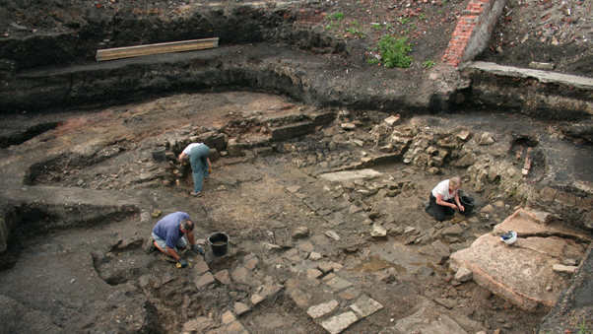
Notes:
The original bath house under excavation by Wallquest volunteers in 2014

Slide 5
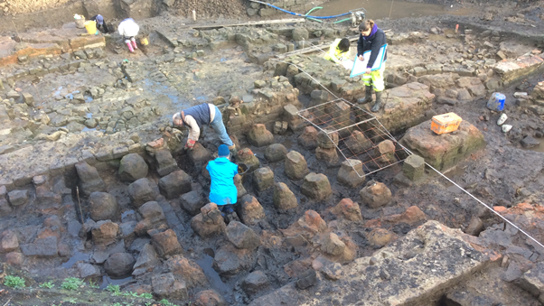
Notes:
The pillars which held up the raised floor in the hot room of the Wallsend baths under excavation by Wallquest volunteers in 2015

Slide 6
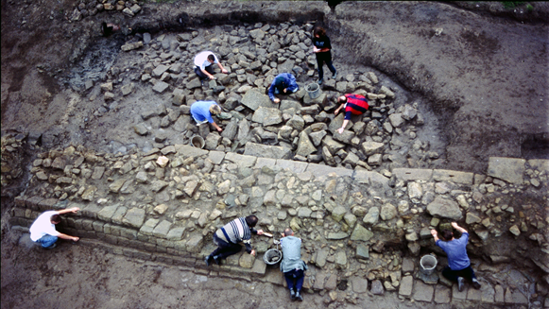
Notes:
Excavation of Hadrian's Wall at Buddle Street in Wallsend.

