Slide 1
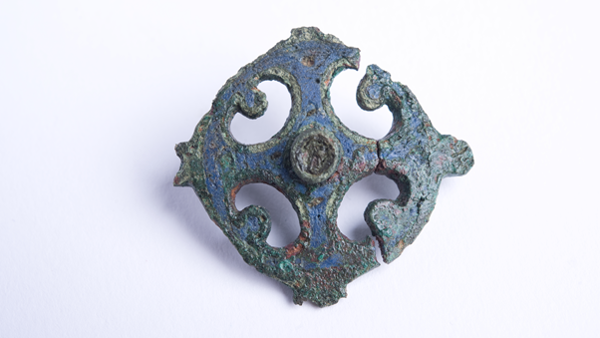
Notes:
This type of brooch may have been used for fastening a woman's tunic. It is decorated with blue enamel, which has survived in very good condition. The openwork shape repeated four times is called a 'pelta' and was a popular design motif with the Romans; it comes from the shape of the shields carried by Amazons.

Slide 2
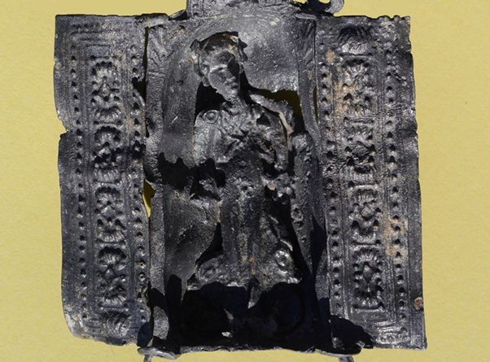
Notes:
This is a portable shrine made of lead, with doors than can be opened and closed. The figure is a cut-out that has been slotted into the shrine; the person who bought this shrine could ask for the god of their choice. In a world without captions, deities are identified by what they wore or carried. These details are not very clear on this figure, but it is thought to be the god Mercury, wearing a hat with wings and carrying a bag of money.

Slide 3
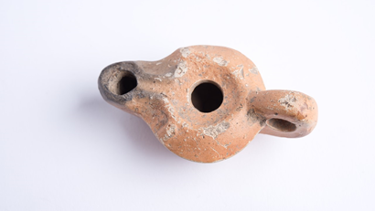
Notes:
This is a pottery lamp for burning olive oil, and soot can still be seen round the nozzle. It holds enough oil to burn for a few hours, but would have to be refilled every day. Oil lamps are not all that common on Hadrian's Wall; most light would have come from open lamps burning animal fats and candles of beeswax or animal fat. This lamp was found in the hospital: it may have been used when treating patients, but as we know lamps were used in funerary rituals, it may have been used with those patients the doctors could not save.

Slide 4
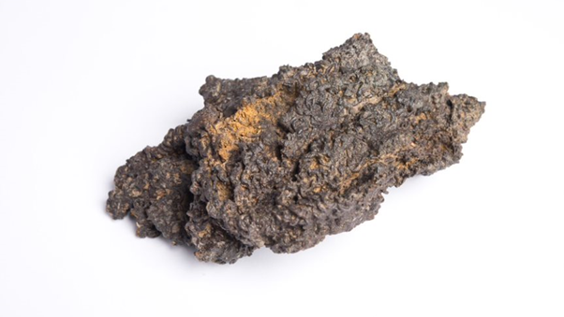
Notes:
A fragment from a suit of iron ringmail armour, made of links approximately 7mm in diameter.
It was found within a pit in a cavalry barrack block and seems to have been a complete shirt when deposited. The size and value of a ringmail shirt suggests it was not simply lost or overlooked, but deliberately buried, possibly as part of a ritual.

Slide 5
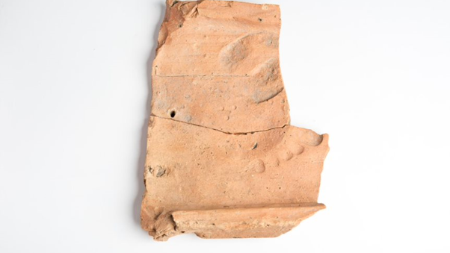
Notes:
A fragment of a roof-tile. While it was laid on the ground to dry before being fired in a kiln a cow and a bare-footed human walked over it. The cow's hoof print can be seen at the top; the toes of the human are visible below.

Slide 6
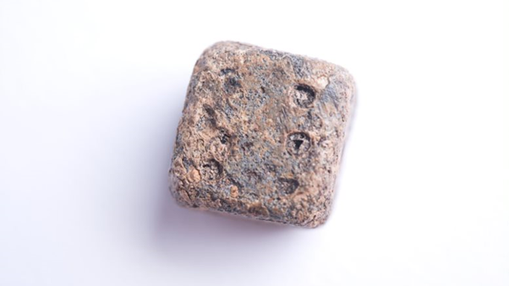
Notes:
A die made of lead. This is an unusual material for dice; most were usually made from antler. The antler dice were probably made by professional craftsmen and then sold. This one is more likely to have been made as a one-off by some-one in a workshop where they had access to hot lead.

Slide 7
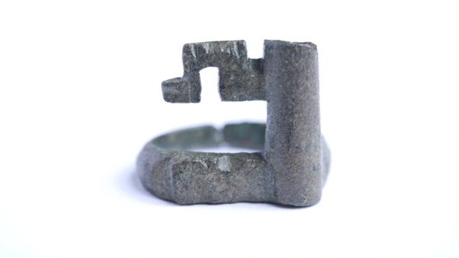
Notes:
Ring key, a small key worn on the finger for extra security. Small keys such as this would be used to lock small boxes or chests that held valuables such as money or jewellery.

Slide 8
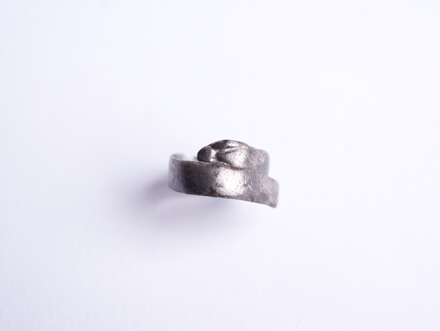
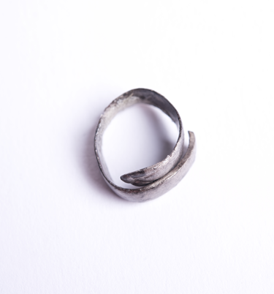
Notes:
Silver ring in the form of a snake; the head can be seen at the top. For some reason such rings are almost always made in silver rather than any other metal. In the Roman world snakes were often associated with health and rebirth (as they shed their skins). This may have been a charm to keep the wearer healthy, or perhaps to show the owner's faith in Aesclepius, the god of healing.

Slide 9
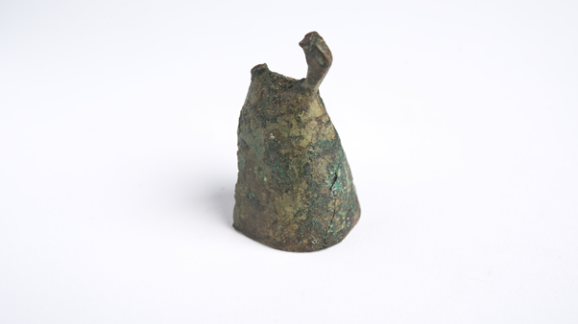
Notes:
Part of a bell. Most Roman bells of this type had a religious function. They were used in religious ceremonies and as part of wine-chimes to give protection against the evil eye. Smaller examples were warn as protective charms by children, and larger ones were worn round the neck of mules, cattle and horses, sometimes as charms and sometimes just to make it easier to locate the animals.

