Slide 1
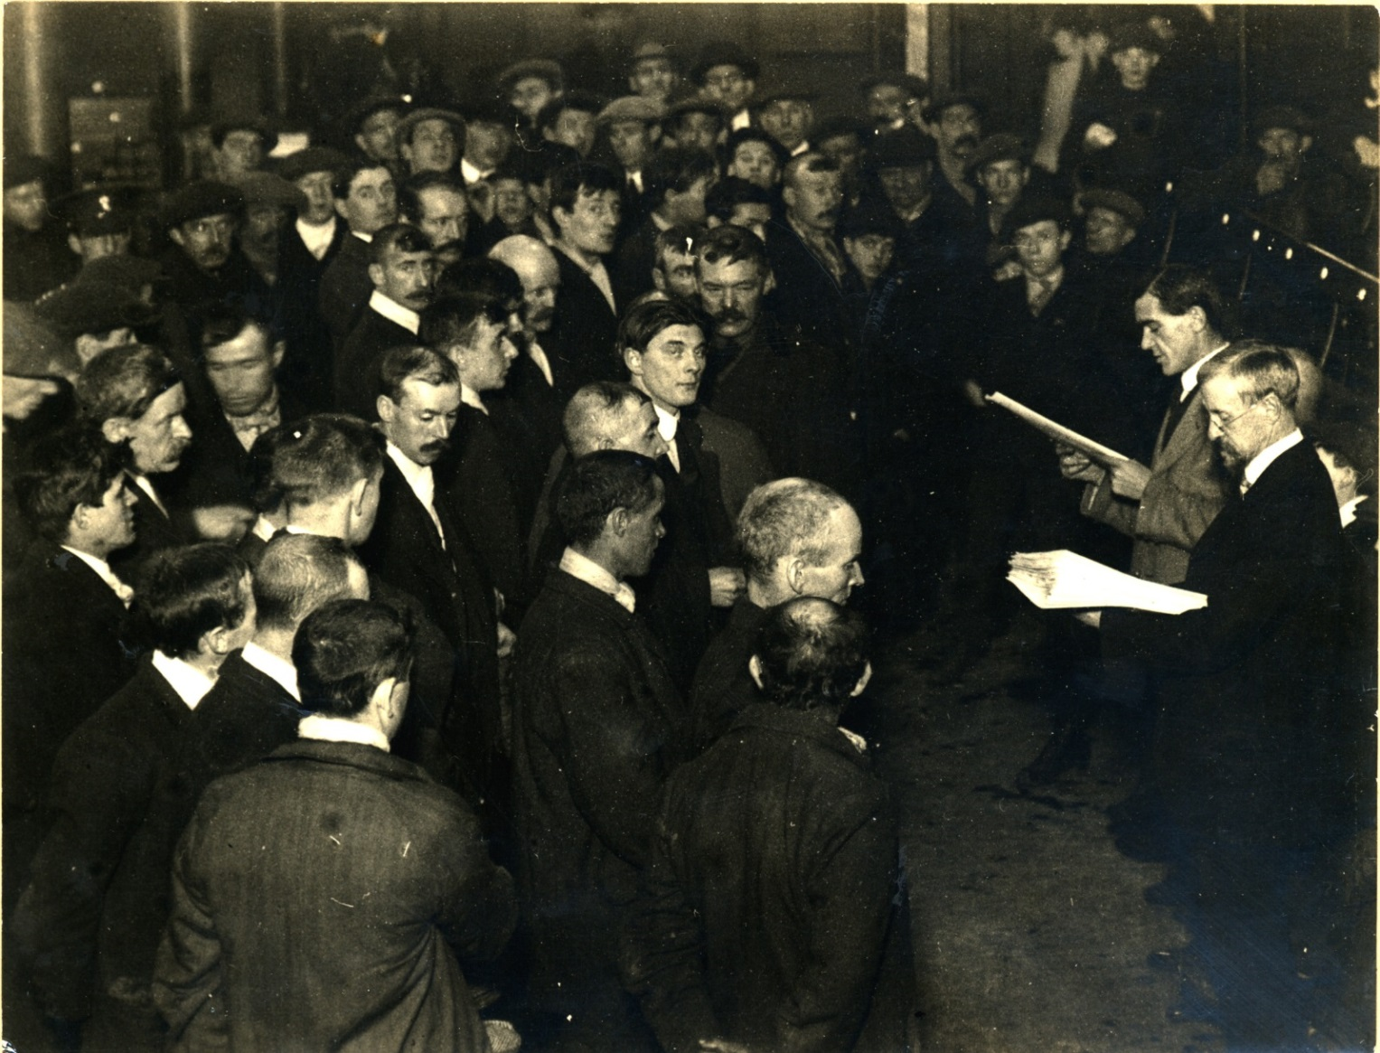
This photograph shows the swearing-in of new Tyneside Irish and Scottish recruits at the Corn Exchange, Town Hall, Newcastle on 12 November 1914.
In August 1914, at the start of the First World War, the British Army had fewer than half a million full-time soldiers. There was a nationwide appeal for men, with an opportunity to enlist at every public gathering.
At half-time on the last League game to be played at St James’ Park in wartime, the Lord Mayor spoke urging volunteers to come forward. Initially, hundreds of thousands of men volunteered.

Slide 2
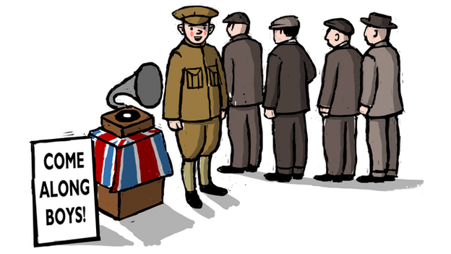
A photograph from 1914 showing a group of soldiers from the Northumberland Hussars.
Men were encouraged to sign up with their friends and work mates and fight together. Around two thirds of the thousand battalions set up in the first two years of the war were local pals battalions.

Slide 3
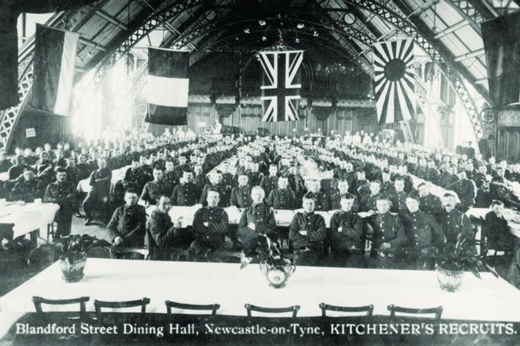
A photograph showing recruits in the Co-operative Wholesale Society dining hall (now Discovery Museum’s Great Hall). Many employers encouraged enlisting and businesses like the Co-op reserved the jobs of employees who joined up and continued to pay them full wages while they were serving.

Slide 4
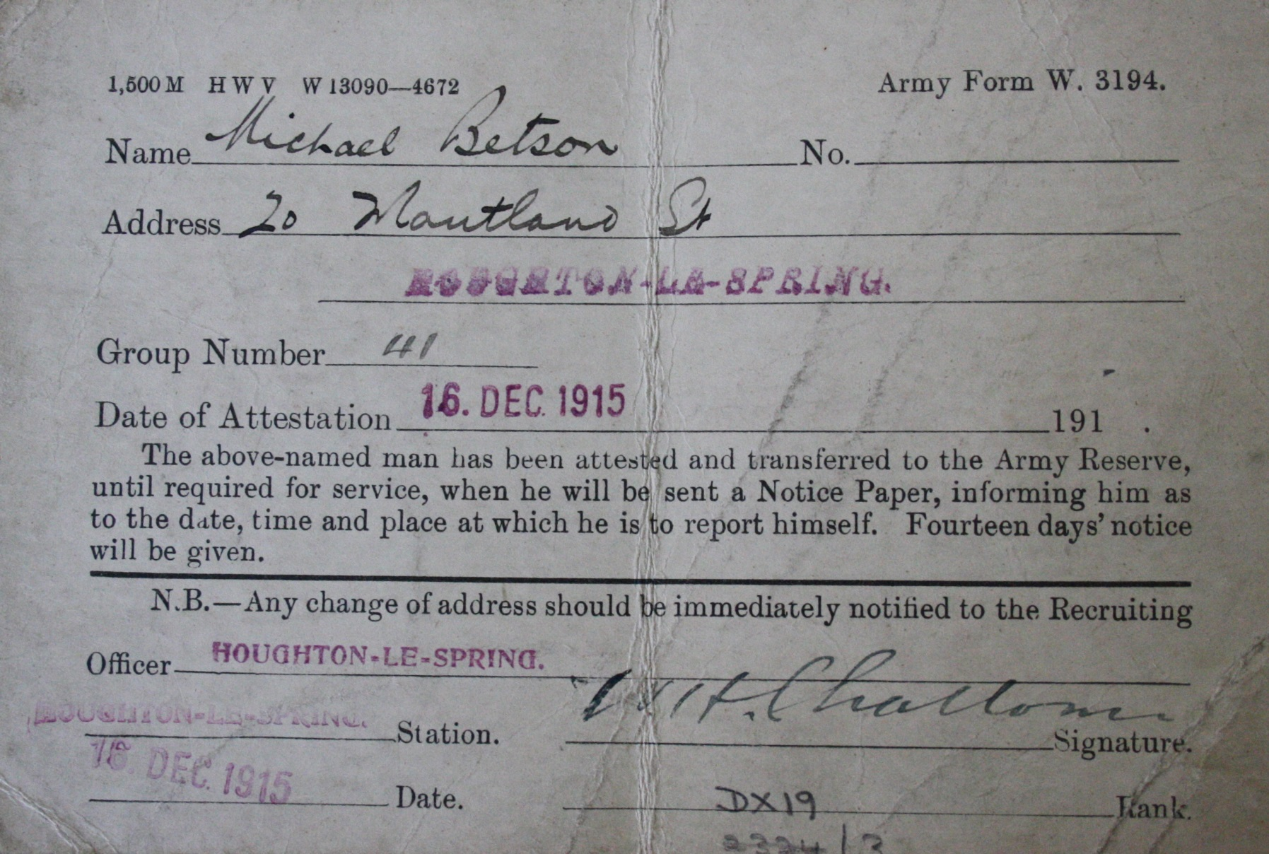
Michael Betson’s Army Reserve form, Michael Benson was a miner from Houghton-le-Spring who had already completed a term of service. (DX19.1)
Although the initial response was overwhelming, news of the awful conditions and casualties at the front quickly spread and the numbers of men volunteering dropped significantly. Army reservists were quickly called up.

Slide 5
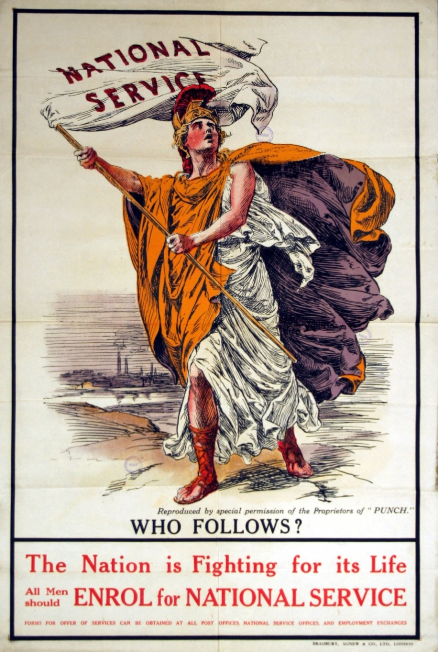
A British propaganda poster (TWCMS:K17102)
Men were put under a lot of pressure to sign up.
Posters were designed to inspire patriotism and make men feel like it was their duty to enlist.

Slide 6
Image: A propaganda postcard (TWCMS:2000.2072)

Slide 7
Image: A National Registration Card from 1915
By 1915 it was clear that voluntary recruitment was not going to provide the numbers of men required for war, so the government passed the National Registration Act to find out how many men between the ages of 15 and 65 there were.

Slide 8
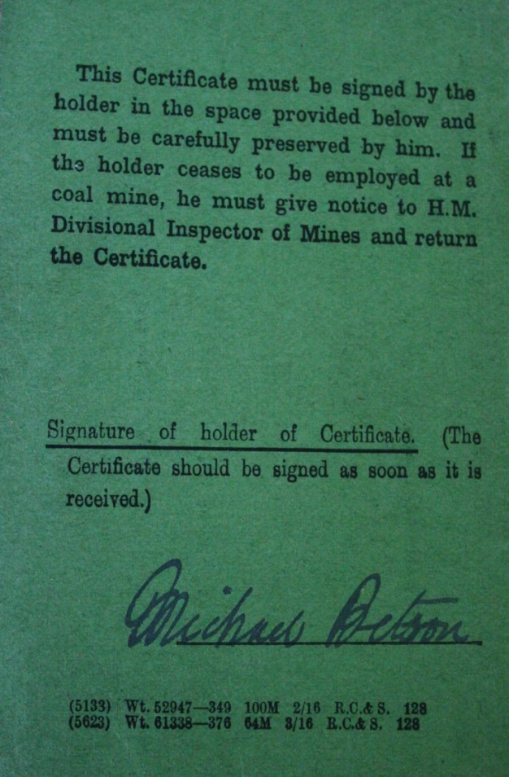
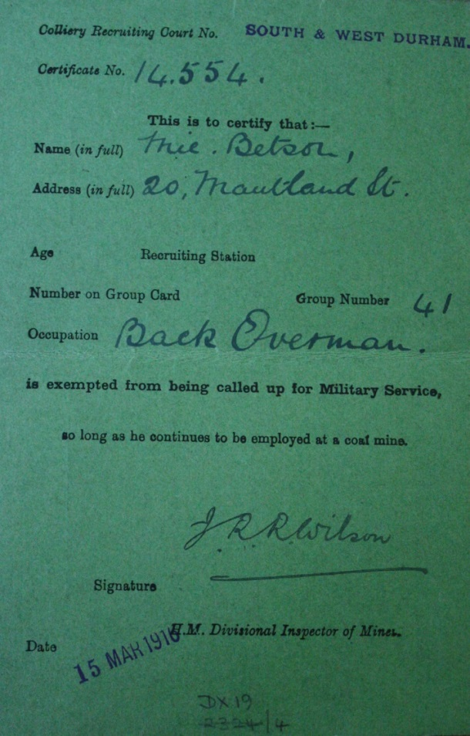
Image: An example of an Army Exemption card given to Michael Betson.
The Military Service Act of 1916 brought conscription into effect for the first time. The act specified that single men between the ages of 18 and 40 would be called up for service. This was later extended to married men and the age limit was raised to 50.
An application could be made for the issue of a certificate of exemption if:
If it is in the nation’s interests that he should be engaged in other work or if he is being educated or trained for any other work that he should continue.
If serious hardship would ensue owing to his financial or business obligations or domestic position
Ill health or infirmity
Conscientious objection to the undertaking of combatant service.

Slide 9
Image: An ‘On War Service’ badge (TWCMS: 2006.6206)
The ‘On War Service’ badge was issued to signify that the wearer was engaged in essential war work.
One of the reasons for issuing the badges was to protect men eligible for military service but engaged in essential war work, so they were not accused of being cowards.

Slide 10
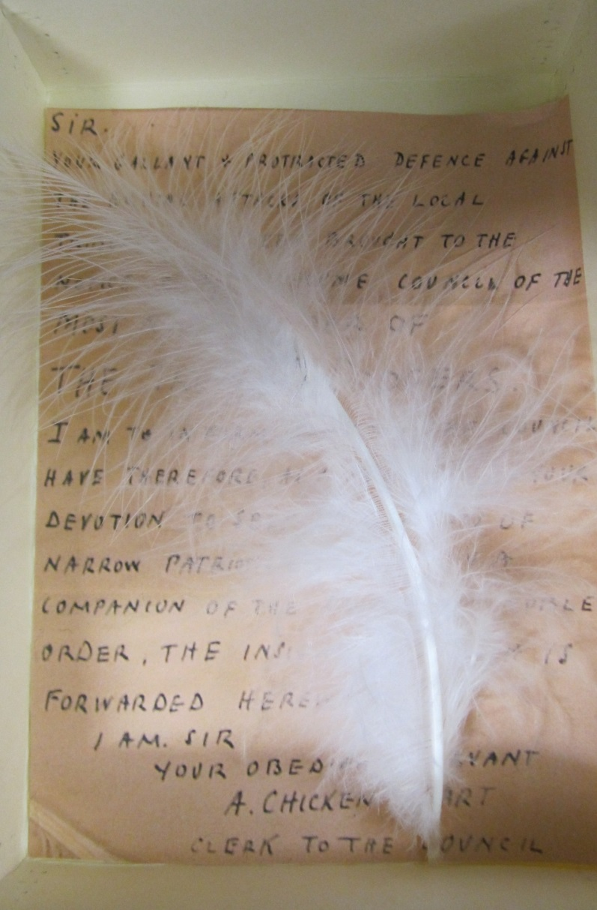
Image: A photograph showing a white feather
Women often presented white feathers to men of military age who had not enlisted and were not engaged in essential war work to brand them as cowards and further pressurise them to join up.

Slide 11
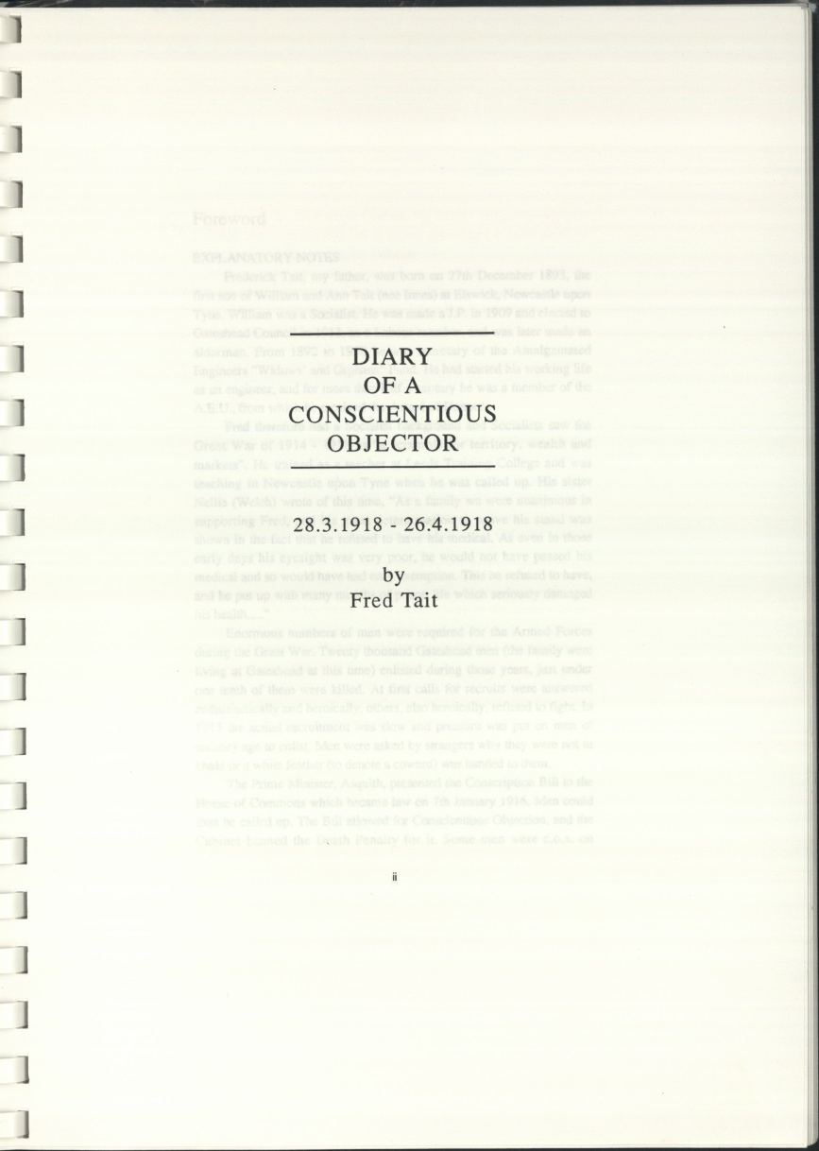
Conscientious objectors were men who refused to fight on the basis of personal, religious, political or humanitarian grounds. Conscientious objectors had to apply to local tribunals for exemption from military service. Out of approximately 16,000 conscientious objectors in Britain at least a third went to prison.
Image: The Diary of a Conscientious Objector by Fred Tait, who was imprisoned because of his political beliefs. (DX1336)

Slide 12
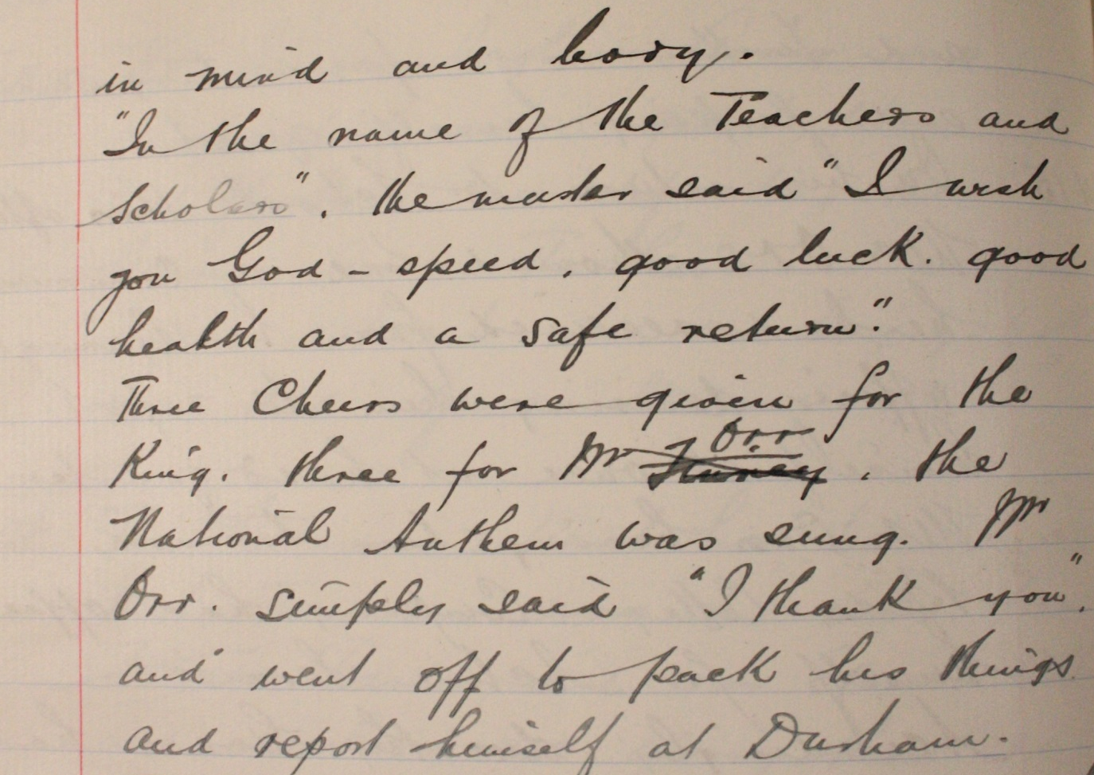
School Logbook
This excerpt from a school logbook describes what happened when someone set off for war.
“In the name of the teachers and scholars, the master said “I wish you God-speed, good luck, good health and a safe return” Three cheers were given for the King, three for Mr. Orr, the national anthem was sung. Mr. Orr simply said “I thank you” and went off to pack his things and report himself at Durham.”

