Slide 1
Women in World War One

Slide 2
In 1915, still in the early stages of the First World War, the British munitions industry found itself in crisis, unable to cope with the demand for ammunition from the front. In response, the government passed the ‘Munitions of War Act’ which saw women enter the workforce and fill the vacant roles of men who had gone to fight.
This photograph shows female munition workers from Scotswood Works. (TWCMS: K18078)

Slide 3
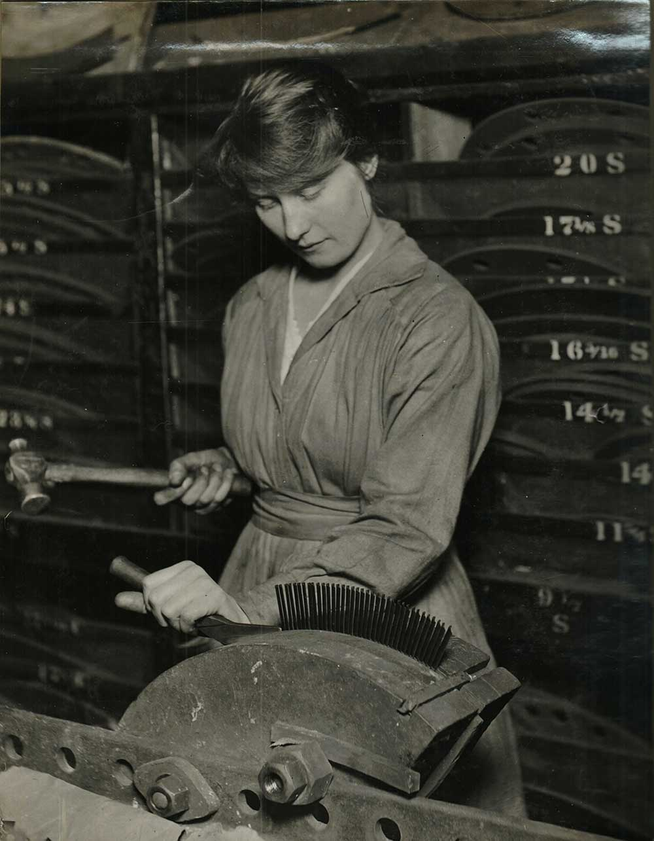
By June 1917, around 80% of British ammunition had been made by munitionettes.
This photograph shows a female worker ‘forming up blading,’ taken from the Parson’s Female Labourers album – a series of photographs taken at Parsons’ Works on Shields Road, Byker between 1914 and 1918.

Slide 4
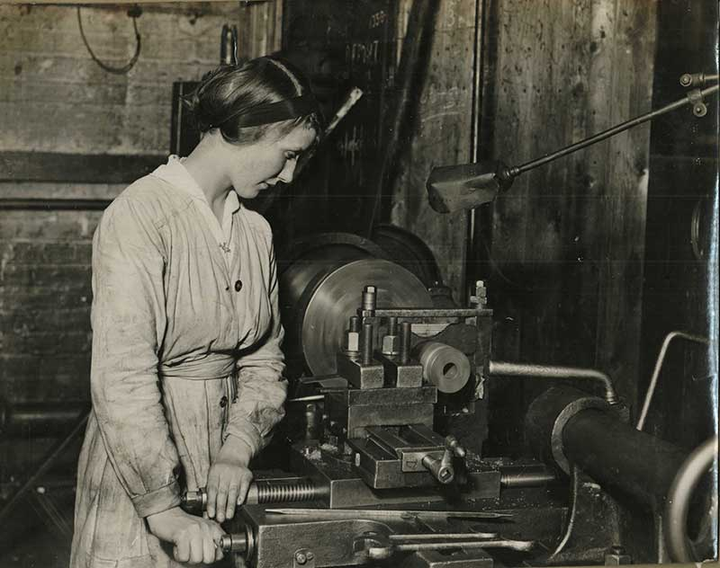
Making munitions was extremely dangerous; the women, who weren’t wearing protective clothing, worked with hazardous chemicals which would turn their skin yellow and factories were at constant risk of explosion.
This photograph shows a female worker ‘working out lathe,’ taken from the Parson’s Female Labourers album – a series of photographs taken at Parsons’ Works on Shields Road, Byker between 1914 and 1918.

Slide 5
A postcard showing a group of women from Armstrong’s Derwenthaugh Fuse Factory in working dress. (TWCMS:2000.5375)

Slide 6
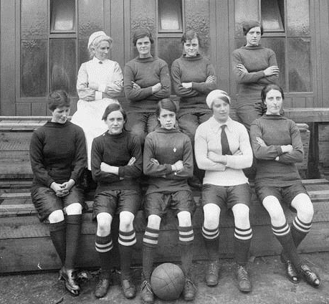
Women working in industry began playing football on their lunch breaks, and soon enough, teams of munitionettes were formed. Mary Lyons of Jarrow (front centre) who played for Blyth Spartans and Palmers. She was and still remains to this day the youngest player to play and score for England in a senior international match, age just 14 in July 1918.

Slide 7
An extract from the diaries of Ruth Dodds, playwright, author and councillor. Dodds was born on 8 May 1890 in Gateshead. During the war she worked in Armstrong’s munitions factory in Elswick and wrote a diary about her experience. (DF.DOD/1.etc.)

Slide 8
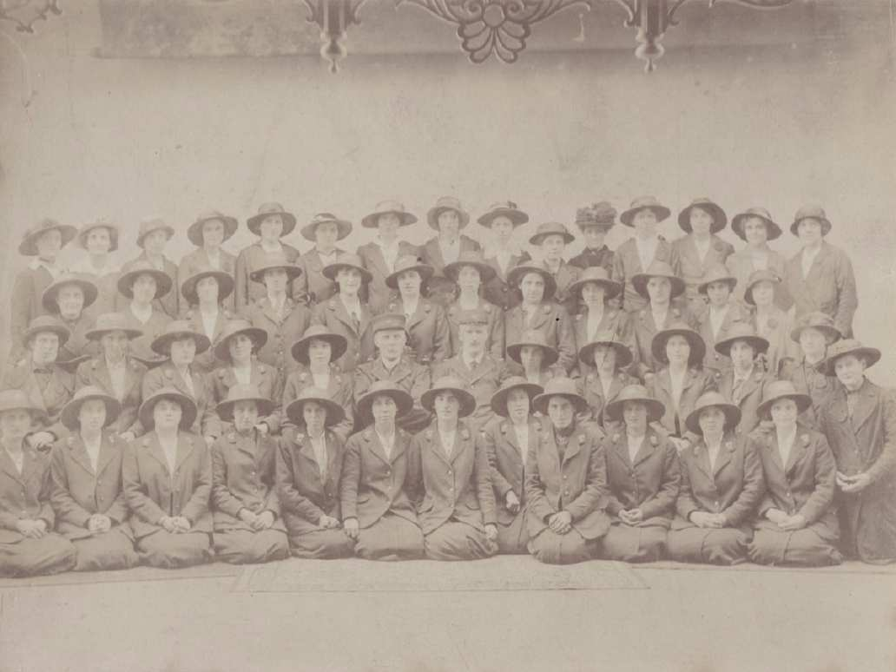
A photograph of women involved in Post Office work during the First World War. (TWCMS: K15340) As male staff joined the armed forces, women became responsible for delivering mail and working as telegraph messengers.

Slide 9
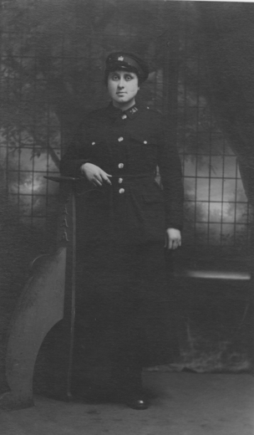
A large proportion of work for women was in transport, and women took on the role of conductress’ and in some cases, drivers on buses and trams. This black and white photograph shows a tram conductress in uniform. (TWCMS: 2000.2048)

Slide 10
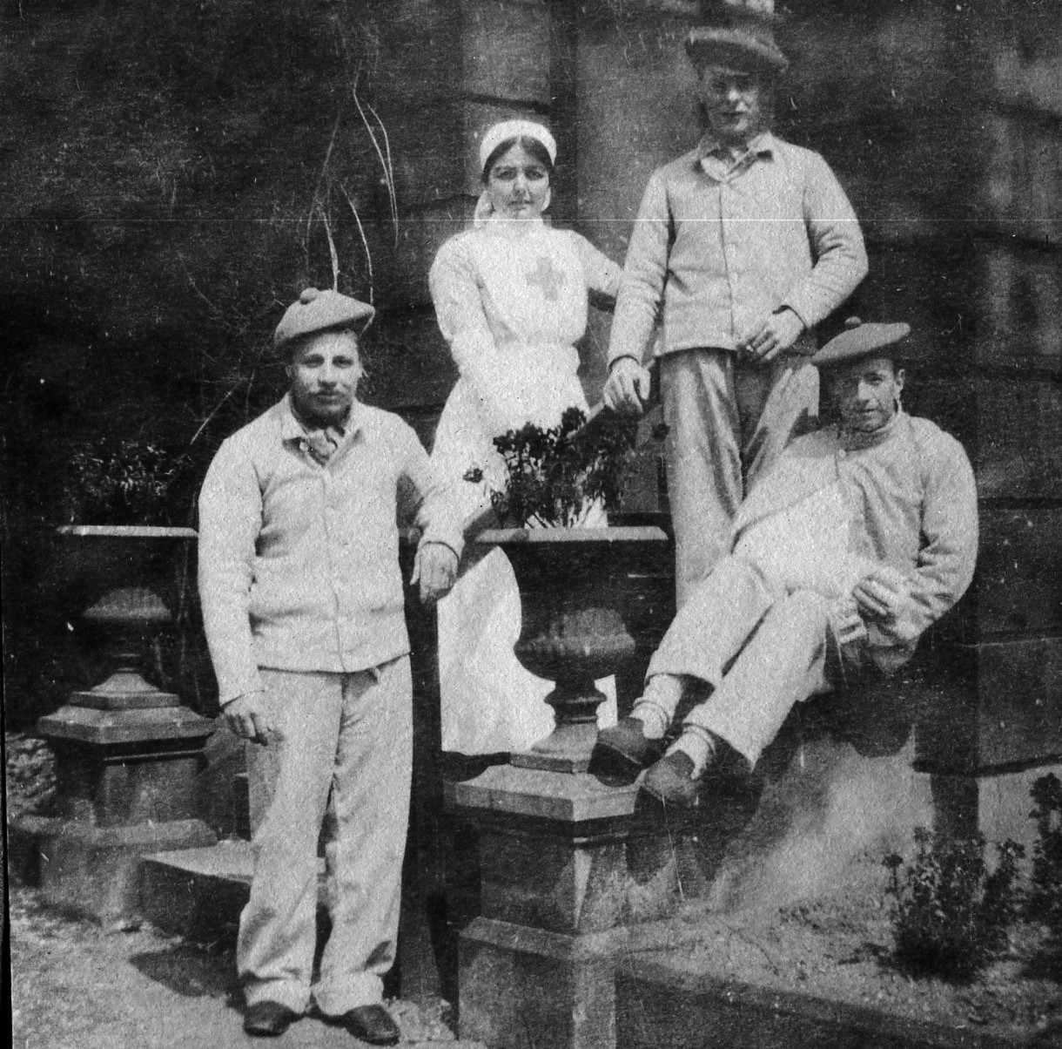
With the outbreak of the war, the number of wounded and injured soldiers rapidly increased and there was a great need for more hospitals and medical staff. Along with licensed, fully trained nurses, voluntary nurses known as Voluntary Aid Detachment (VAD) willingly gave their time to care for the wounded.
This photograph shows a nurse at the 25th Durham VA Hospital in Ashburne, Sunderland with recovering patients.

Slide 11
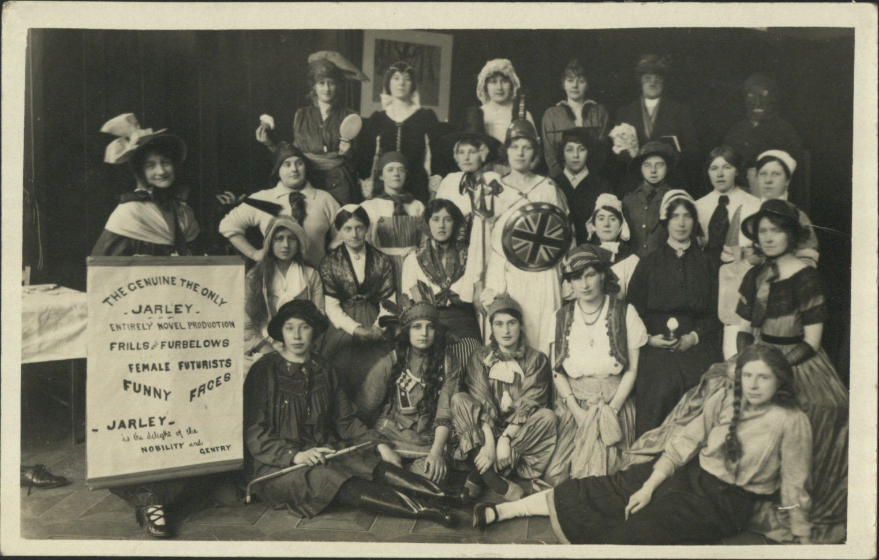
This photograph shows a group of nurses in costume for a Christmas performance at the 3rd Northern General Hospital in Sheffield in December 1916. (DF.BGS/4/7/3)

Slide 12
Like the men fighting away at war, Nurses were also sent away from home and their families to the front to provide aid to military and naval forces.
This postcard shows a horse drawn ambulance with soldiers standing in the cart and two nurses attending to a sick patient. (TWCMS: 2000.2177)

Slide 13
On War Service Badge.
The On War Service badge was issued exclusively to women workers ‘engaged in the manufacture of munitions of war or other urgent war work.’ Over 270,000 were issued between May and December 1916. (TWCMS: N67)

Slide 14
Princess Mary Tin
This tin was sent by Princess Mary to members of the British, Colonial and Indian Armed Forces for Christmas 1914. Over 426,000 tins were sent and were filled with various items including, tobacco, cigarettes, confectionery, spices, a Christmas card and a photograph of the Princess. (TWCMS: F9617)

Slide 15
March 11 1915:
A letter from Buckingham Palace to Mrs Elizabeth T Toad, conveying Her Majesty the Queen’s most grateful thanks for her kind contribution to the comforts of the troops at the front. (TWCMS: 2008.1242)

Slide 16
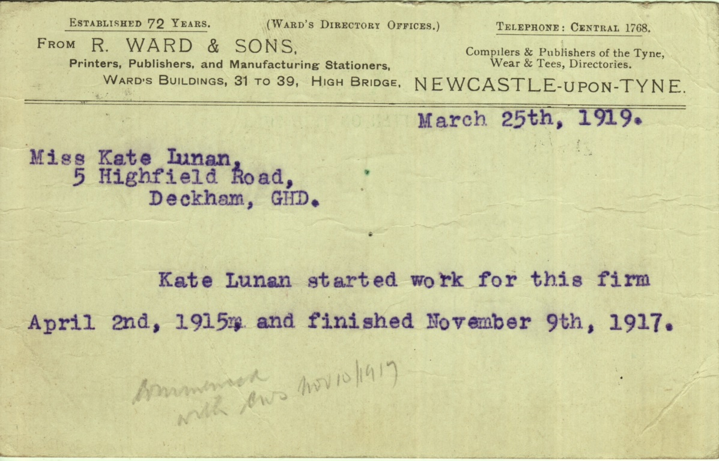
March 25 1919
A postcard from R Ward & Sons confirming that Miss Kate Lunan started work for the firm on April 2 1915 and finished working on November 9 1917. (TWCMS: 2011.1401)
As the war drew to a close, men returned home and went back to work, resulting in women losing their jobs and new found freedom.

