Slide 1
Laing Art Gallery
Lindisfarne Gospels
P
O
S
T
V
I
S
I
T
P
A
C
K

Slide 2
End of journey activity:
Curriculum Links: Geography, DT, Art, PHSE
This task will encourage children to focus on their personal and regional identities.
Let’s make our own special book to document our journey!

Slide 3
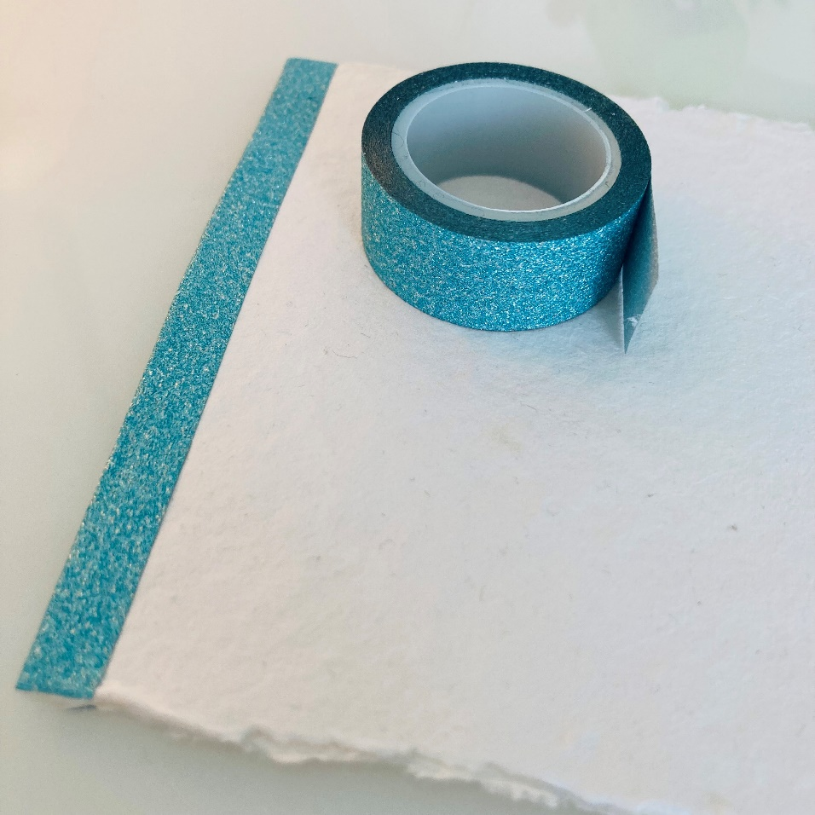
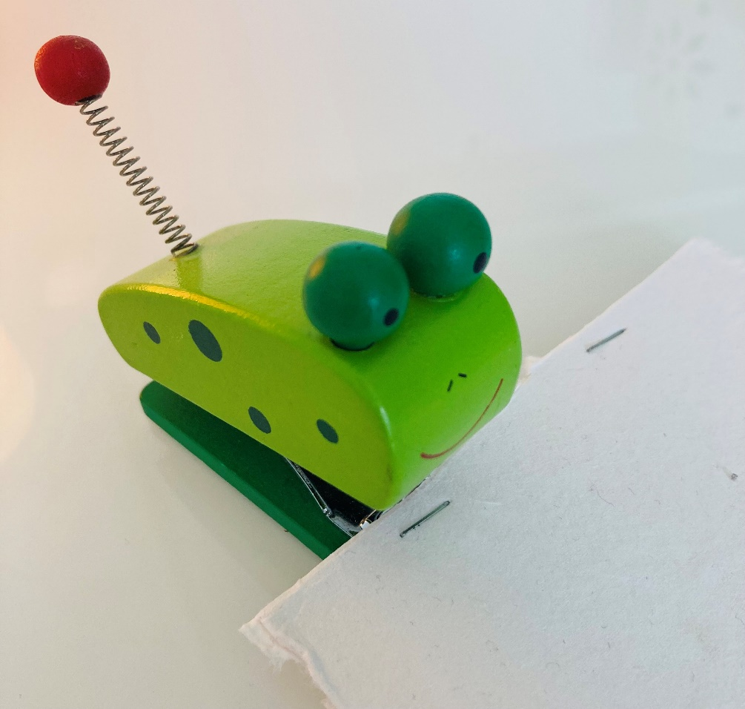
There are many simple ways we can bind our books:
1
Staple and add a Washi or masking tape binding
Step 1
Staple the pages together along the binding edge about 2cm from the edge.
Step 2
Now cut a piece of tape about 3cm longer than your book. Place half the tape on the front of the book, covering the staples, wrap the tape over the edge of the book and around to the back. Make sure you press it down firm. Trim off the excess tape with scissors.

Slide 4
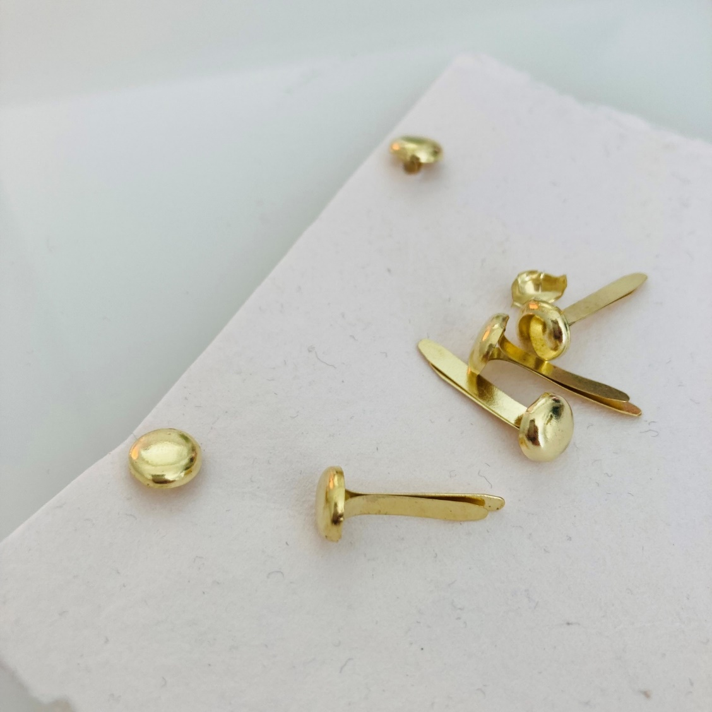
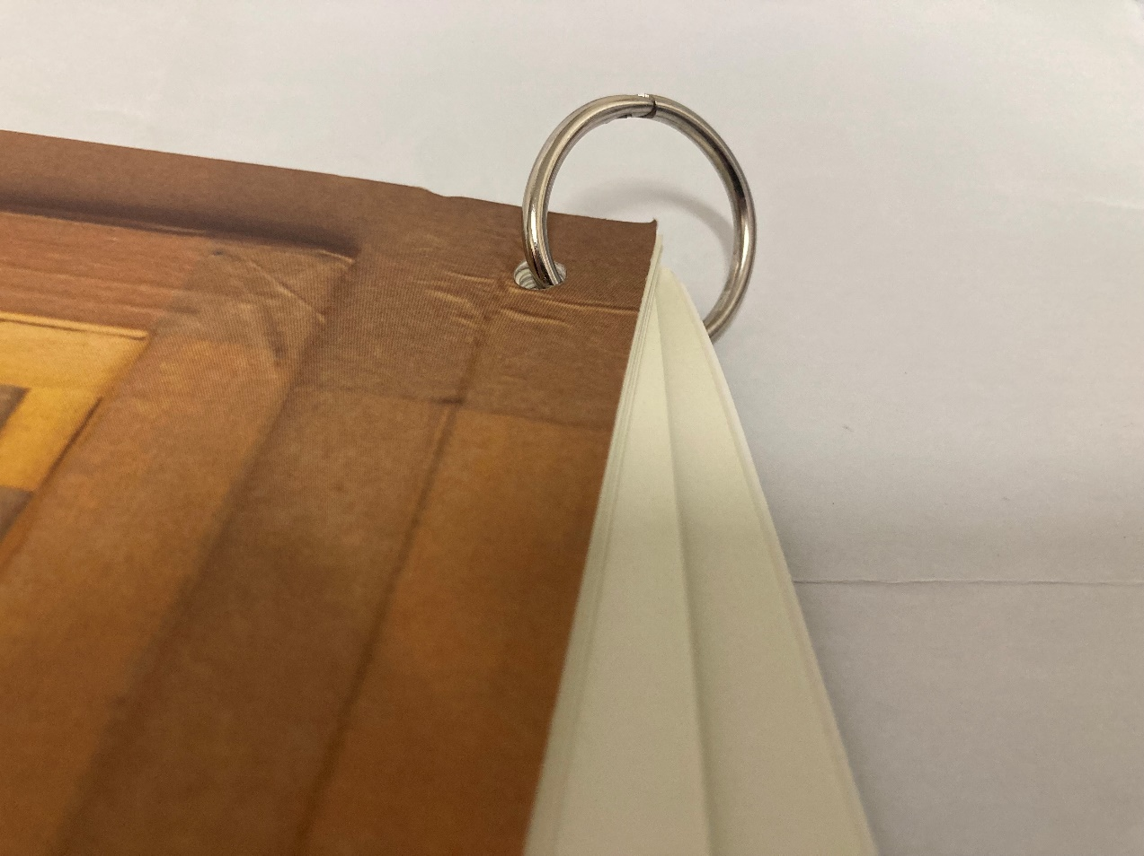
3
Hole punched and paper fasteners
2
Book rings
Book rings can be purchased from any craft or art shop and are a quick and uncomplicated way to make a book. Hole punch pages in the corner and add to the book ring. Simple as that!.
If your book is a little thicker, use a 2- or 3-hole punch to make holes along the edge of your book. Add paper fasteners to the holes. This method makes it easy to replace or add extra pages to your book.

Slide 5
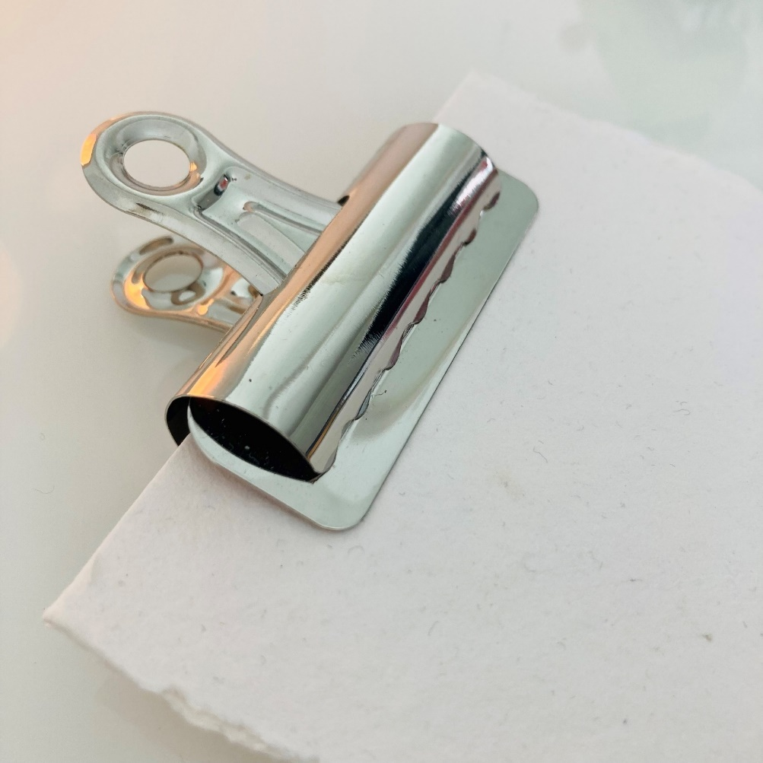
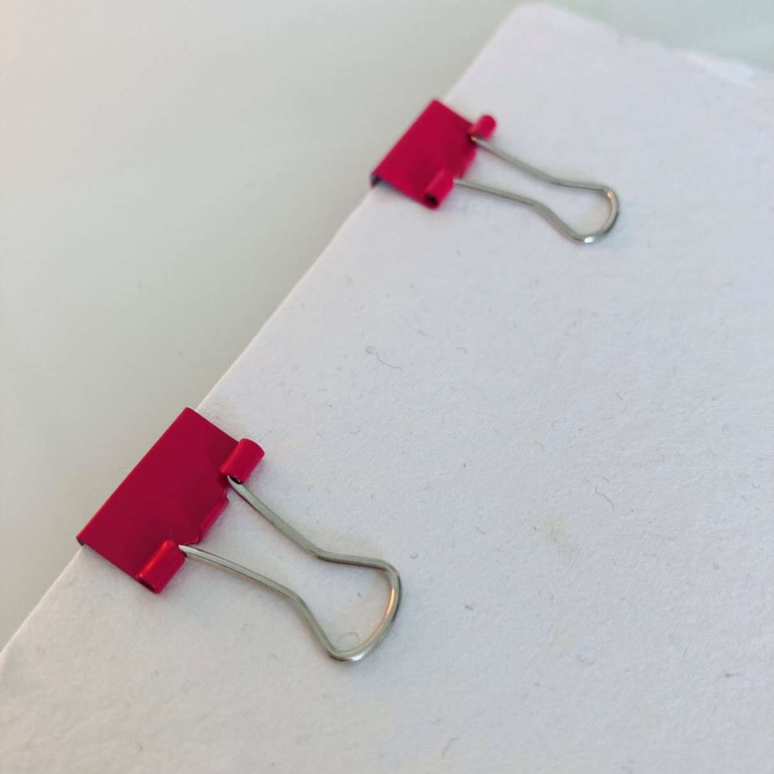
4
Stationery clips
Stationery clips or bulldog clips are a straightforward way to create a book but make sure you leave plenty of space so that your writing and drawing does not get hidden away beneath them when you try and open your book. Leave at least 3cm at the left-hand side of each page blank if this is going to be your chosen method.

Slide 6
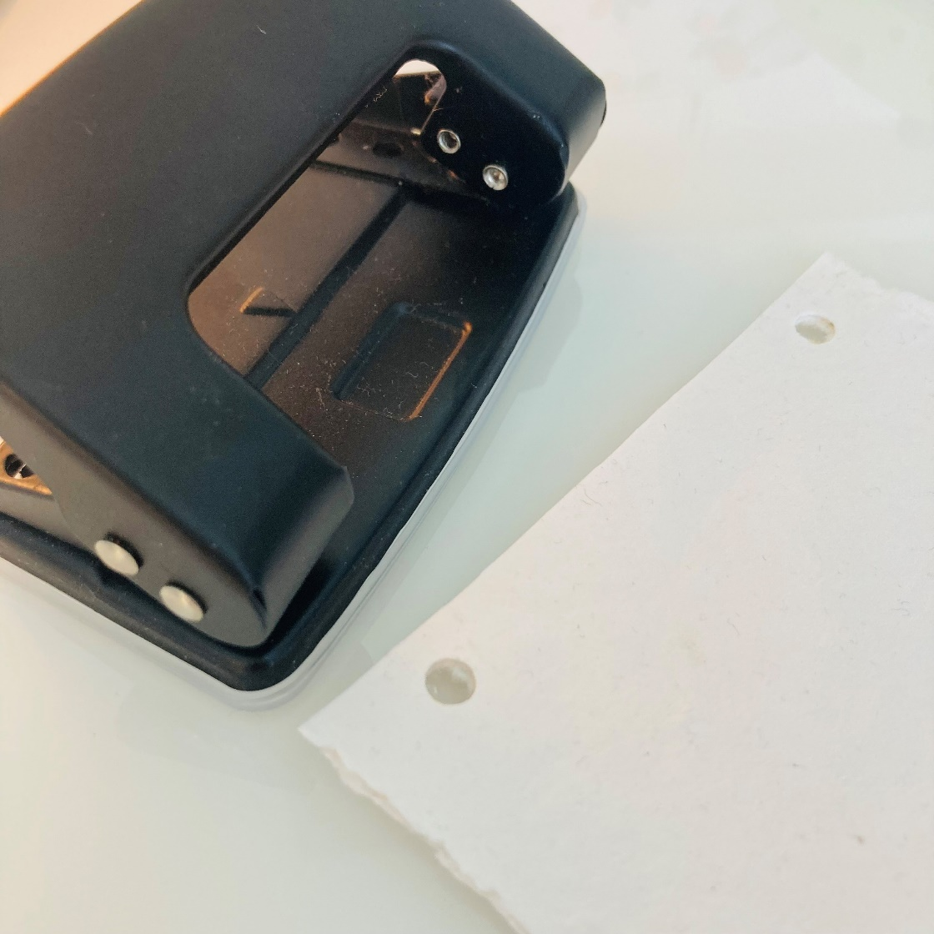
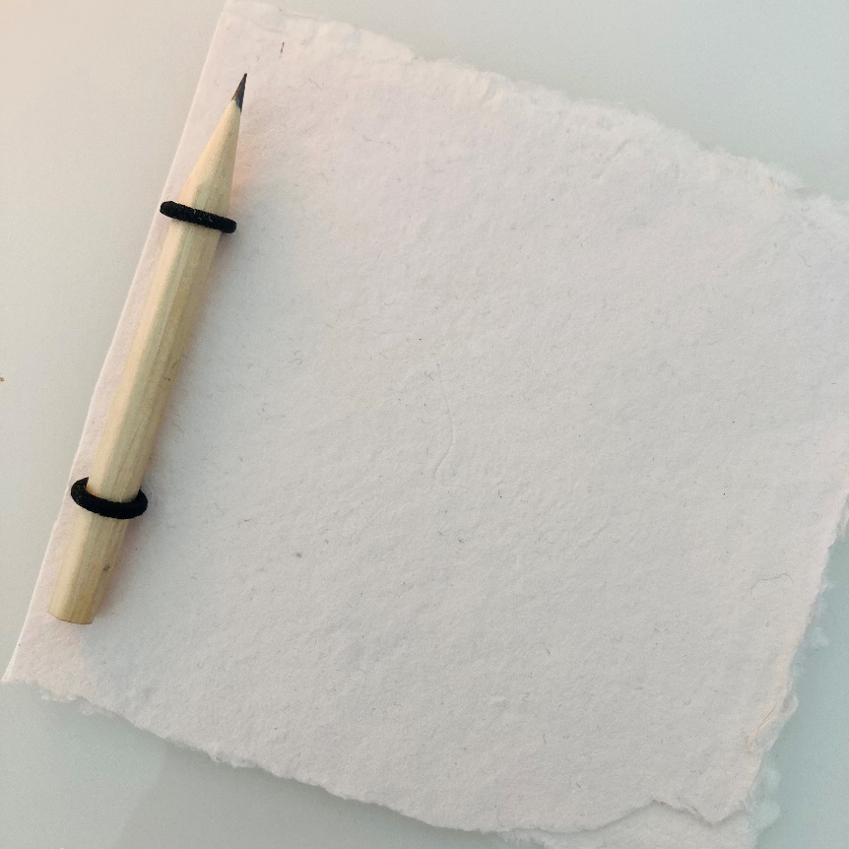
5
A pencil and elastic band
For this method you need to create holes using a hole punch. Line up your dowel / pencil / stick at the front and feed the ends of the elastic band through and loop over the ends. This creates a really strong binding edge for your book.

Slide 7
Curriculum Links: Geography, DT, Art, PHSE
What can we include in our book?
The Lindisfarne gospels are all about people, news, stories, and journeys.
Create a map of a journey that is special to you and brings back happy memories.
Create a map of a journey that is special to you and brings back happy memories!

Slide 8
Where did you go?
What did you see?
What did you feel?
What did you hear?

Slide 9
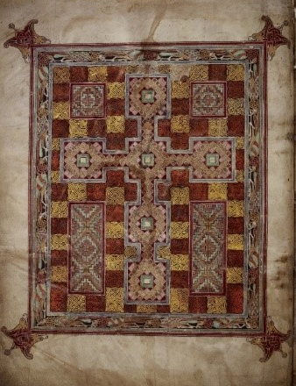
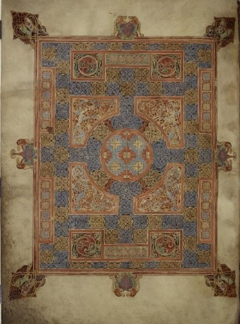
Carpet pages
What is a carpet page?
Teacher notes from the British Library:
“The decoration of the manuscript, which combines Celtic, Germanic, Insular and Mediterranean elements, is famed for its intricacy and beauty. The manuscript includes five full pages of patterned decoration, known as carpet pages, around the shape of a cross. These occur before the opening of the first preface by St Jerome, and before each of the four Gospels. In each case these carpet pages face elaborately painted pages, with enlarged, intricately decorated, initial letters and colourful display script, for the opening words of Jerome’s preface and each Gospel. This decorative approach is also applied to the ‘Chi-rho’ page where the text of Matthew’s Gospel records the birth of Christ.”
Can you create a carpet page for your book?

