Slide 1
Laing Art Gallery
Lindisfarne Gospels
A
C
T
I
V
I
T
Y
P
A
C
K

Slide 2
Teacher Notes:
Links to the National Curriculum and where these resources fit within the framework:
History KS1:
History KS2:
Pupils should develop an awareness of the past, using common words and phrases relating to the passing of time.
Britain’s settlement by Anglo-Saxons and Scots
Examples (non-statutory)
This could include:
They should know where the people and events they study fit within a chronological framework and identify similarities and differences between ways of life in different periods.
Anglo-Saxon invasions, settlements and kingdoms: place names and village life
Anglo-Saxon art and culture
They should use a wide vocabulary of everyday historical terms.
Christian conversion – Canterbury, Iona and Lindisfarne
They should ask and answer questions, choosing and using parts of stories and other sources to show that they know and understand key features of events.
They should understand some of the ways in which we find out about the past and identify different ways in which it is represented.

Slide 3
Teacher Notes:
Links to the National Curriculum and where these resources fit within the framework:
Art KS1:
Pupils should be taught:
Art KS2:
Pupils should be taught:
to use a range of materials creatively to design and make products
to develop their techniques, including their control and their use of materials, with creativity, experimentation and an increasing awareness of different kinds of art, craft and design.
to use drawing, painting and sculpture to develop and share their ideas, experiences and imagination
to create sketch books to record their observations and use them to review and revisit ideas
to develop a wide range of art and design techniques in using colour, pattern, texture, line, shape, form and space
to improve their mastery of art and design techniques, including drawing, painting and sculpture with a range of materials [for example, pencil, charcoal, paint, clay]
about the work of a range of artists, craft makers and designers, describing the differences and similarities between different practices and disciplines, and making links to their own work.
about great artists, architects and designers in history.

Slide 4
Teacher Notes:
Links to the National Curriculum and where these resources fit within the framework:
Geography:KS1/2/3
Locational Knowledge:
name and locate counties and cities of the United Kingdom, geographical regions and their identifying human and physical characteristics, key topographical features (including hills, mountains, coasts and rivers), and land-use patterns; and understand how some of these aspects have changed over time.
human geography, including: types of settlement and land use, economic activity including trade links, and the distribution of natural resources including energy, food, minerals and water
Pupils should develop knowledge about the world, the United Kingdom and their locality. They should understand basic subject-specific vocabulary relating to human and physical geography and begin to use geographical skills, including first-hand observation, to enhance their locational awareness.
Pupils can:
use maps, atlases and globes to identify the United Kingdom and its countries, as well as the countries, continents and oceans studied at this key stage.
use aerial photographs and plan perspectives to recognise landmarks and basic human and physical features; devise a simple map; and use and construct basic symbols in a key.

Slide 5
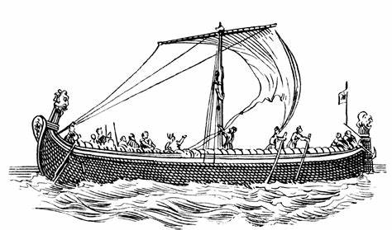
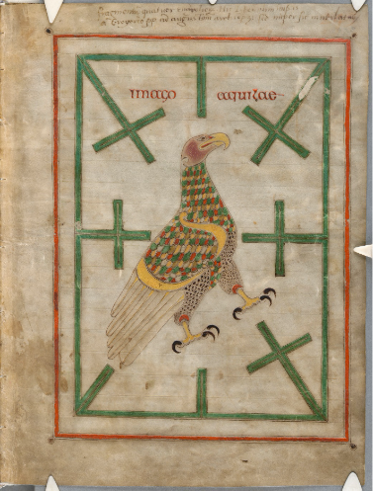
Lindisfarne and the sea
Curriculum links: GEOG, HIST, DT, ART, ENGLISH, MFL, PHSE
Anglo Saxons had many links with the outside world. Archaeologists around the UK have excavated merchants houses and found goods that were bought and sold from places as far away as North Africa, the middle East and Sri Lanka. They traded across the known world in their vessels like the illustration in the picture.
The sea was an important part of life on Lindisfarne. Food was usually sourced locally and at Lindisfarne, people relied on ‘Fruits of the sea’: oysters / cockles / fish / seals/ sea birds. The sea was how we connected with other cultures and carried latest ideas, folk lore, news, goods and much more.

Slide 6
How do we do this now?
Can you think of some good news you could share?
Think about an event or something you did that you really enjoyed.
Who were you with?
Where were you?
Could it make someone else happy too?
Why did it make you happy?
What did you do?
Use this information to write an article about it on your template for ‘The Lindisfarne Times’.

Slide 7
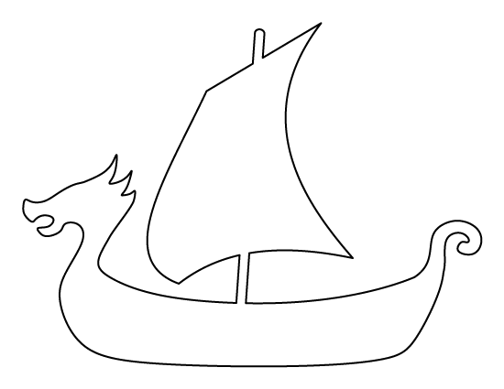

Slide 8
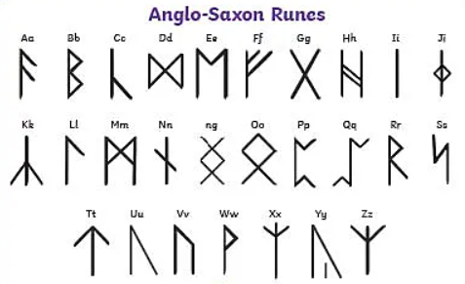
Could you write the title or your name in Anglo Saxon runes?

Slide 9
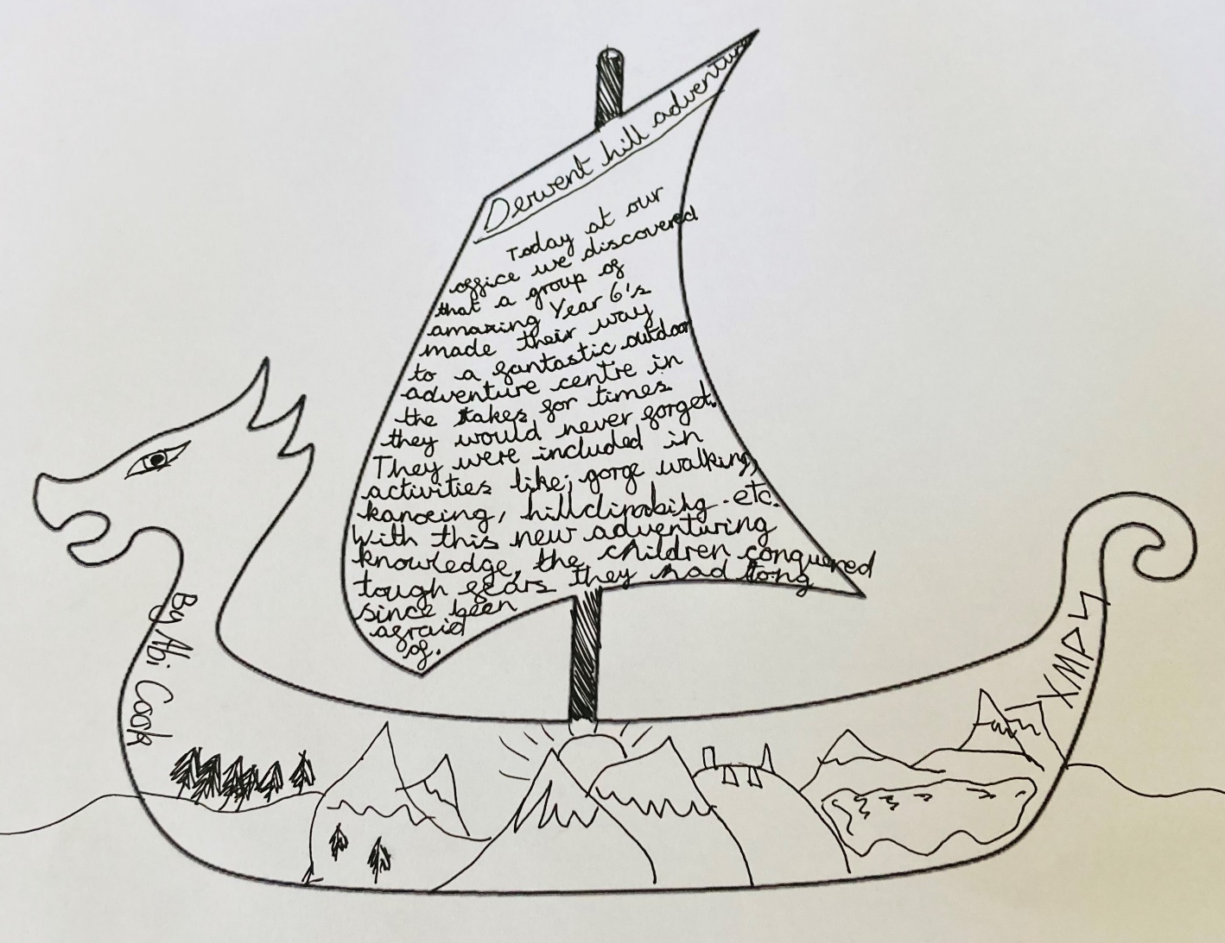
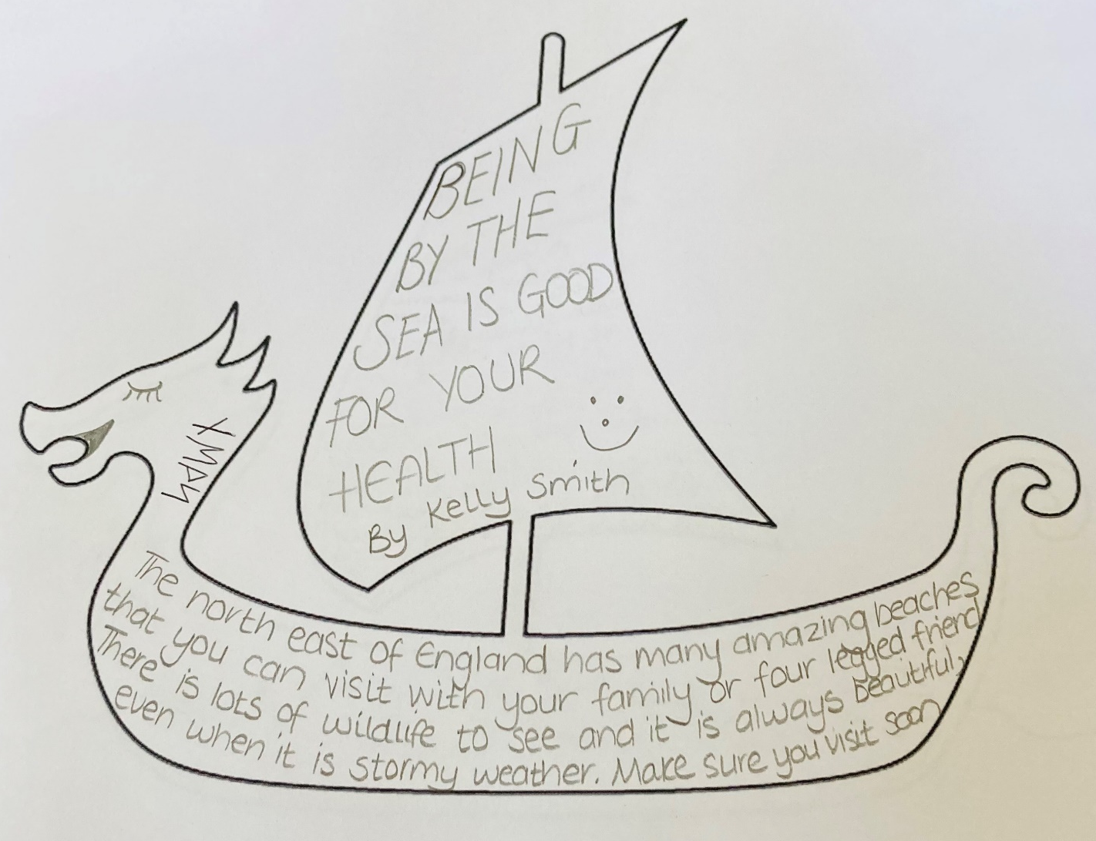
Read the examples below for some ideas
Use the template to create your own

Slide 10
Curriculum links: Science, Art, DT, History
Making Paint
We know what the gospels were about but how were they made?
The Gospels were decorated by monks, using a restricted number of pigments, made from a variety of vegetable and mineral sources, which were combined skilfully to create a wide palette of colours. At the moment, evidence suggests that the inks used on the Lindisfarne Gospel were created with locally sourced ingredients. A tiny amount of gold was also used in the decoration.
Copying text by hand into a manuscript was a slow process, especially when the script was written as carefully and regularly as in the Lindisfarne Gospels. The intricate decoration in the Gospels would have taken a long time to create. It has been suggested that it may have taken between five and ten years to produce the 518 pages of the gospel-book.
Anglo-Saxon trade can be shown by just one item: ink. Every monastery would need ink for writing and would make their own. The ingredients for some of the inks had to be gathered from around the world.
Black ink is made from gall nuts from oak trees, gum Arabic (from tree sap), vitriol ((a type of chemical) and wine.
The best gall nuts came from Syria, gum Arabic from Sudan, vitriol from Spain and wine from the Mediterranean!
Different coloured inks required even more specialist materials – red ink – mercury from Spain, green ink – honeysuckle and blue ink – woad, both found growing in every monastery garden. Just think of all those beautiful colours created from ingredients from around the world in Anglo-Saxon times!

Slide 11
Let’s try to create our own water-based paints to create a decorated manuscript just like the Anglo-Saxon monks that created the Lindisfarne Gospels. We can forage and search for materials and ingredients in our homes and classrooms.
To create your paints, you will need:
• Pots / jars / containers to mix your paint in
• Water – cold and hot (ask an adult for help)
• Forks, potato mashers, stones to grind up materials.
Materials with a lot of pigment. Look at the list below for ideas:
SPINACH
BLUEBERRIES
CARROTS
MUD
STRAWBERRIES
COFFEE
GRASS
TURMERIC
CHILLI POWDER
POLLEN
BEETROOTROSE PETALS
MUSTARD POWDER
CHERRIES
TEA – try different herbal combinations for different colours.
Make sure you work with an adult and remember that some of these ingredients can irritate your skin or make it look a funny colour (chilli powder/turmeric).

Slide 12
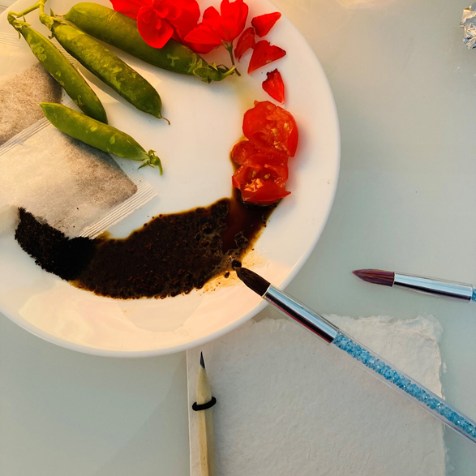
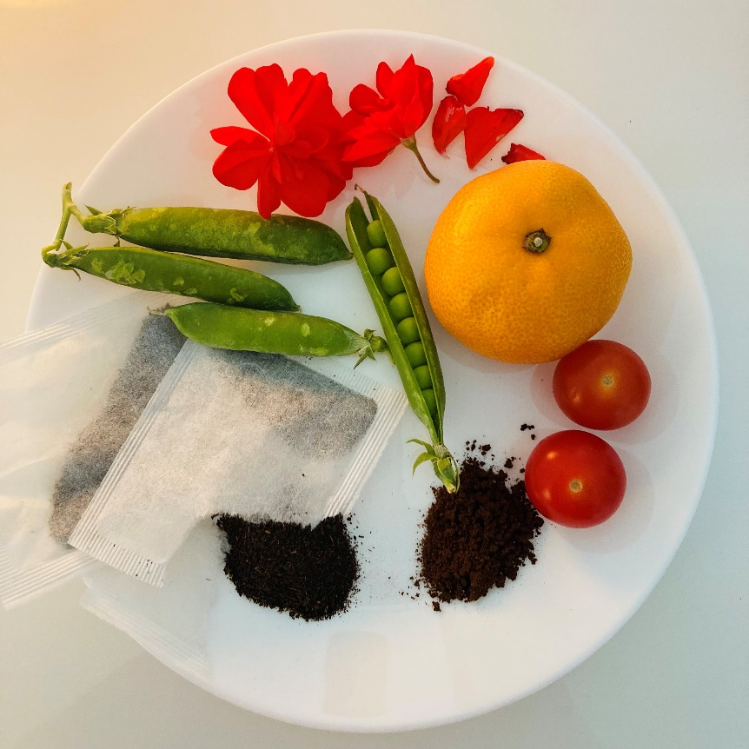
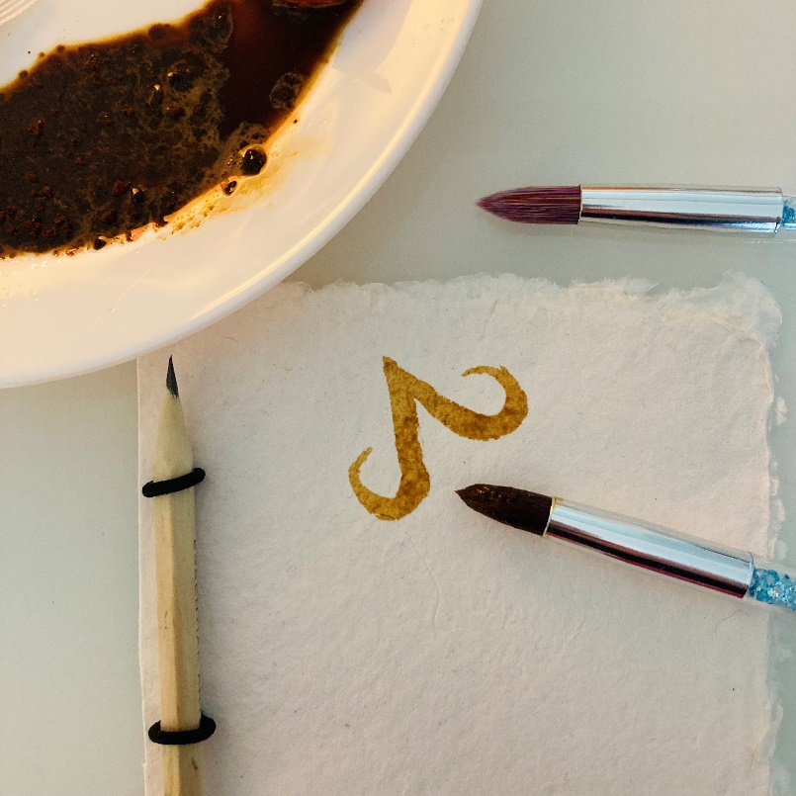
Step 1
Release the colour!
Use a fork or a small stone to release the colour from your materials. Do this by chopping, scraping and rubbing your materials against the side of your container.
Teachers – if you have a blender, you can puree the fruits and vegetables to make the process quicker.
If you are using leaf like materials such as rose petals and spinach, add a little hot water as this will help to release the colour. (Adult supervision required).
Step 2
Bind the materials
Bind the pigments by adding a tiny bit of water. You could add egg white too but be mindful of anyone who may have egg allergies. If you want to thicken your paint add a tiny amount of flour.
Step 3
Get painting
You are now ready to start to paint! Why not create a colour chart listing all the materials you have used and record the colours you created? Use the template below to record your experiments. Remember - Adding more water will make a paler colour.

Slide 13
Use the template below to see how many different colours you can create

Slide 14
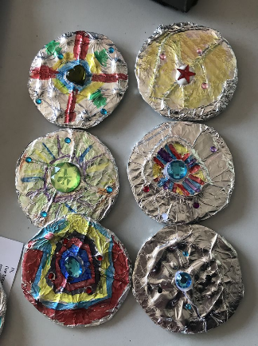
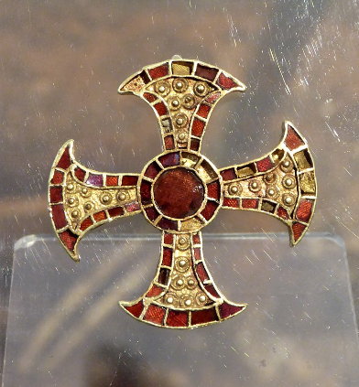
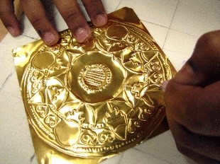
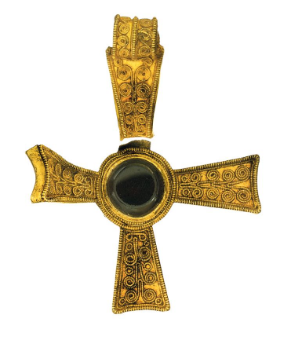
Anglo Saxon Treasure
Anglo Saxon jewellery was made from gold, bronze and silver. Whitby jet and amber from the Baltic region were popular stones. Necklaces and bracelets were made from glass beads too. They were objects to show status and wealth.
A famous Anglo Saxon burial ground called ‘Sutton Hoo’ held many Anglo-Saxon treasures from across the known world. There were silver bowls from Byzantium, Garnets from Sri Lanka and gold coins from Northern Italy.
Create a piece of Anglo-Saxon jewellery for your character using papier Mache, cardboard, or foil to create a pendant.
A quick and easy way to do this is to cut out your shape using cardboard. Wrap the cardboard in foil and add details using colourful permanent marker pen or acrylic paint.

Slide 15
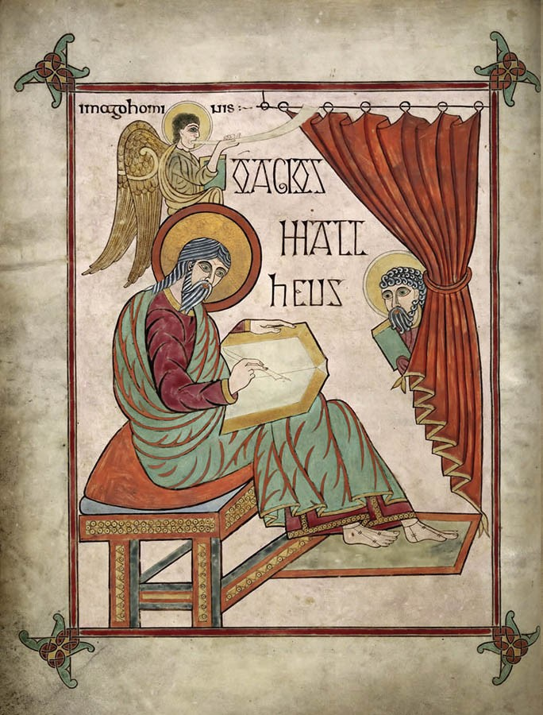
The 'Evangelist Pages'
The Lindisfarne Gospels also contain 'Evangelist Pages' These are portraits of the 4 evangelists:
Matthew, Mark, Luke and John
Can you work out which Evangelist this is? How do you know?

Slide 16
What does this page tell you about Matthew?
Look for words and symbols that give you clues about Matthew and his life
His name was Mattheus - Matthew in Latin
He is dressed in the style of a Greek/Roman wear a Toga and sandals
He was a writer
He has a book and pen
He was a Saint
He has an angel behind him and a halo
From looking at his appearance we can tell he is an older man

Slide 17
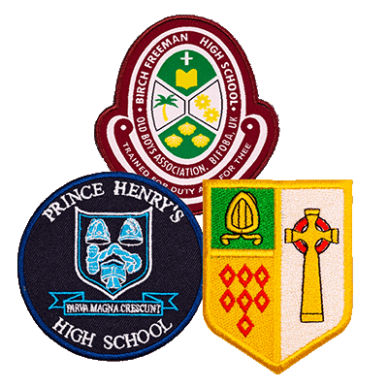
This page contains symbols
What is a symbol? Can you think of any modern symbols today?
Have a look at the other Evangelist portrait pages. They are also full of symbols
What do you think the other symbols mean?
The lion? The Ox? The Eagle?

Slide 18
TASK
Can you have a go and add your own portrait to your book?
What symbols would you use to tell people about yourself?
Create a map of a journey that is special to you and brings back happy memories.
For example, I would put some goggles in mine, because I love swimming

