Slide 1
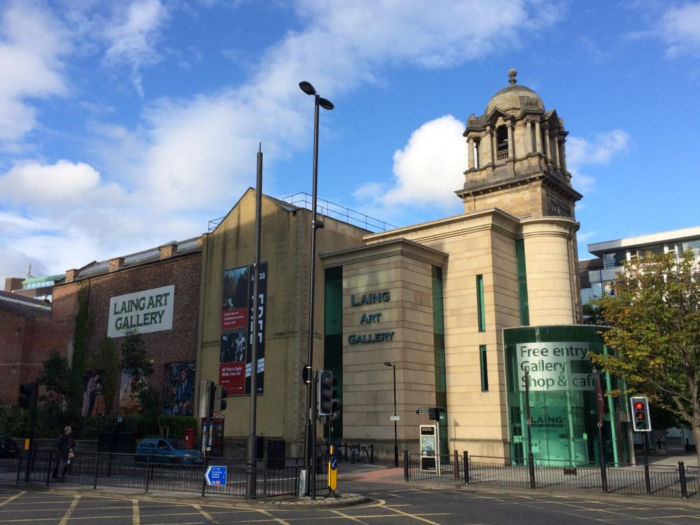
Notes:
This is a pre-visiting tool.
There will be notes on each slide which you can decide to use (or not use)

Slide 2
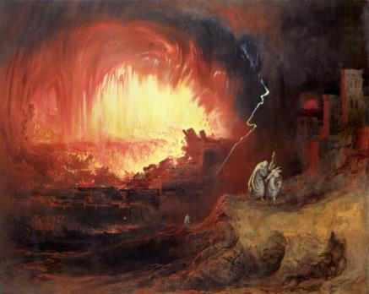
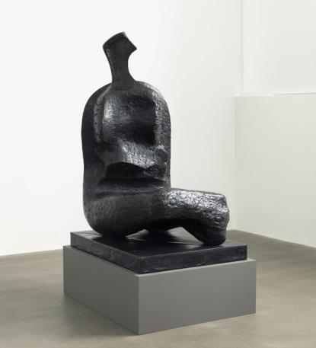
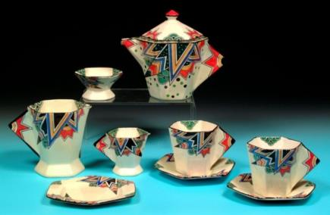
What can YOU see at the Laing?
Oil Paintings and Watercolours
Sculptures
Prints
What other types of art
might you find in our gallery?
Decorative Arts
Notes:
*Glass *drawing ect

Slide 3
How many pieces of art do you think the Laing has?
It has over
pieces of art!
22,300

Slide 4
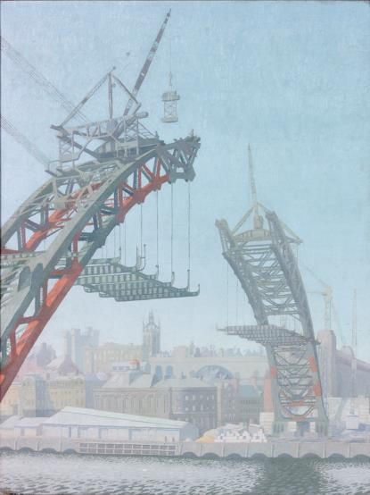
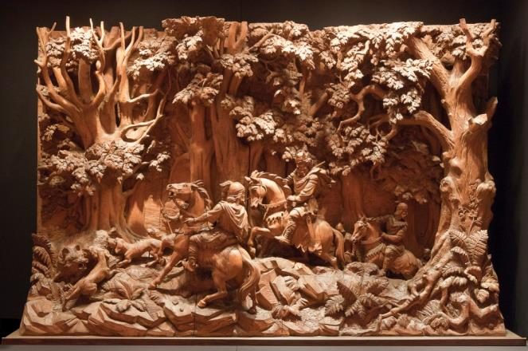
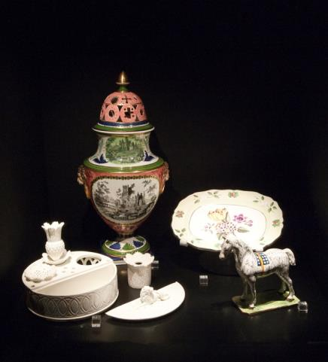
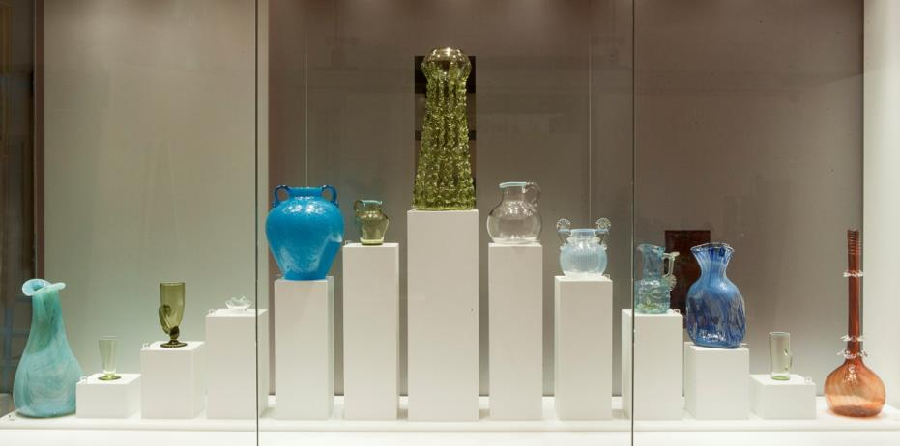
We have lots of artworks made right here in the North East.
Have you seen this bridge before?
Notes:
Gerrard Robinson (1834-1891) Carving
Sowerby Glassworks, Gateshead
Newcastle Pottery
Edward Montgomery O'Rourke Dickey, (1894-1977) ‘The Building of the Tyne Bridge’, 1928.

Slide 5
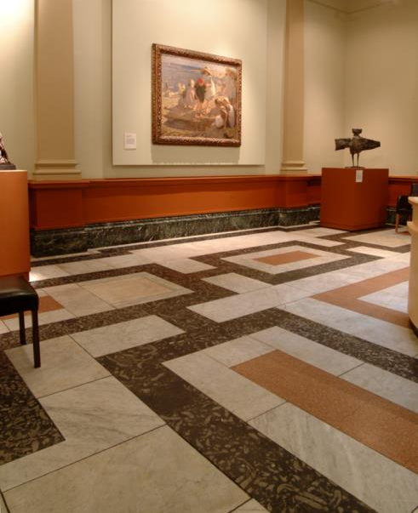
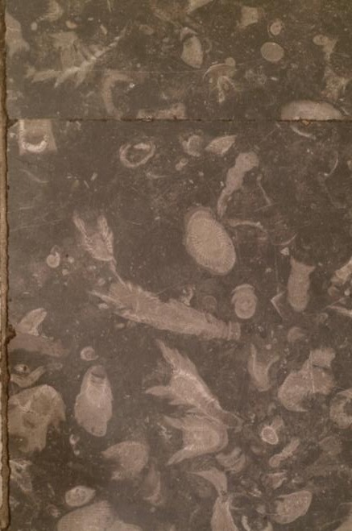
This is the floor in our Marble Hall.
What can you see within the marble?
Notes:
This is a detailed picture of the floor in the great hall. Within the marble there fossils.

Slide 6
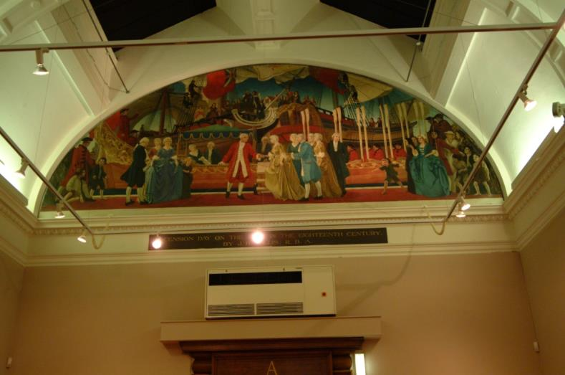
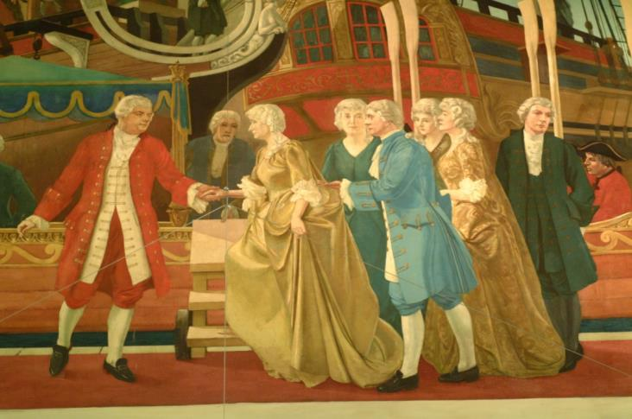
On your visit, don’t forget to look up!
What can you see?
Notes:
This is one of the Lunettes ‘Ascension day on the river Tyne in the Eighteenth Century’ in Gallery A

Slide 7
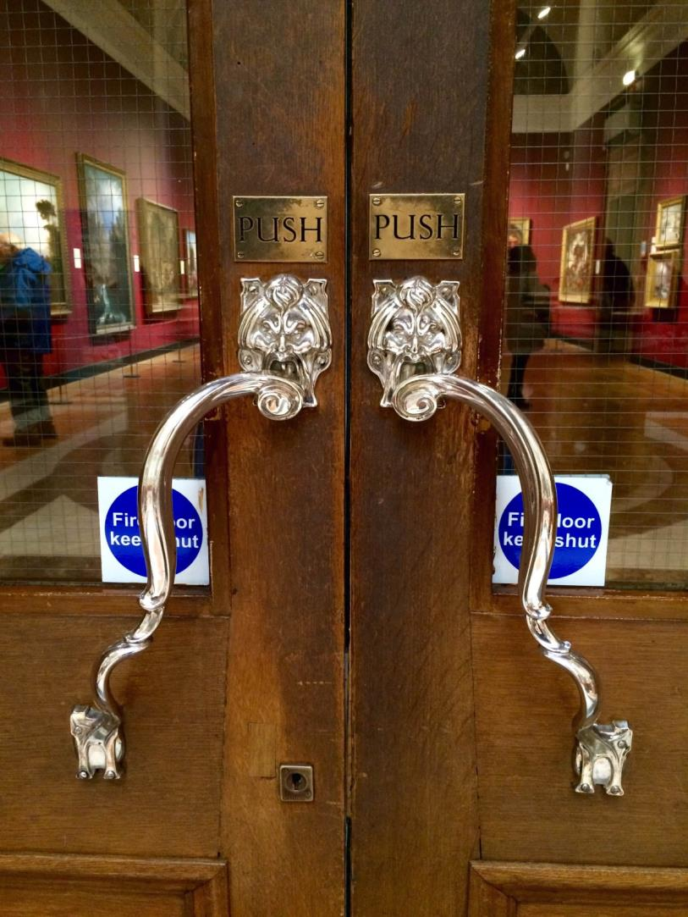
In the gallery, there are some artworks that you can actually touch!
Can you guess what these are?
Door handles!

Slide 8
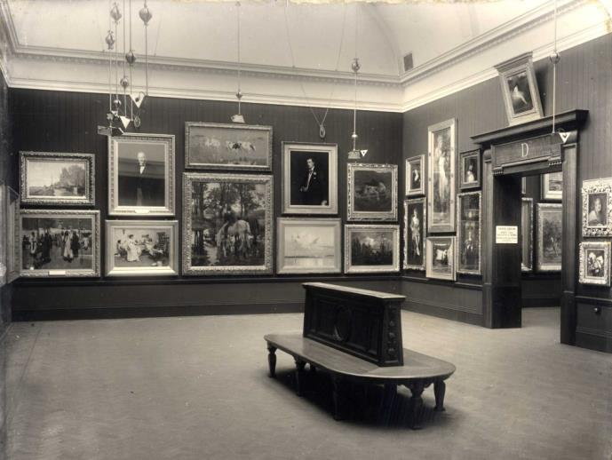
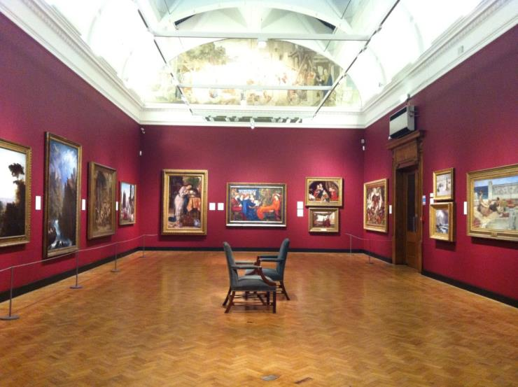
Has much changed?
Look closely at these 2 photographs of the same gallery at the Laing Art Gallery…
How has it changed?

Slide 9
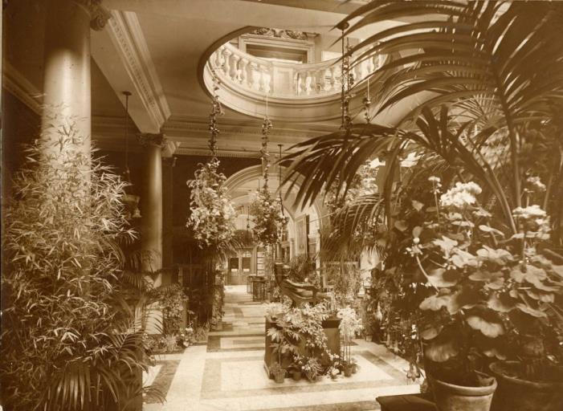
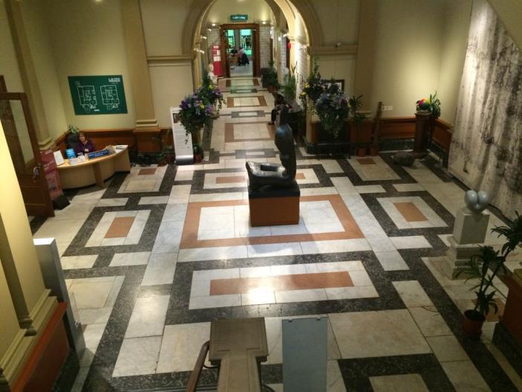
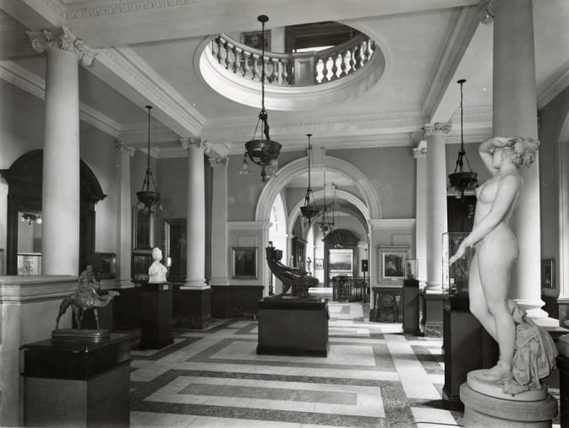
This is the Marble Hall.
How has it changed?
Are there things that have remained the same?
Notes:
These are three different images of the Marble Hall at the Laing from three different time periods.
(top left) The first shows the hall housing vast numbers of plants
(middle right) The second shows it being used as sculpture gallery (sculpture in the middle of the room in this picture is now upstairs by the entrance of the 18th century room)
(bottom left) taken 30/04/15, Henry Moore sculpture in the middle of floor

Slide 10
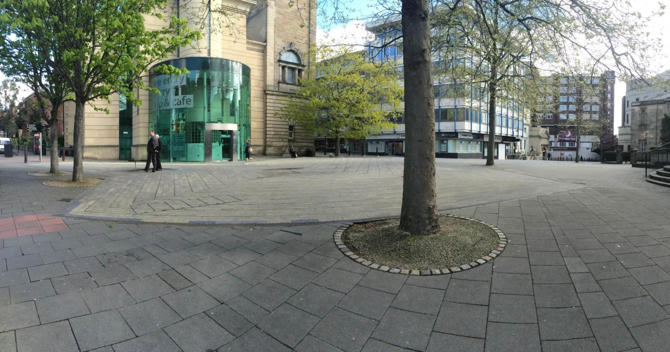
We look forward to meeting you very soon!

