Slide 1
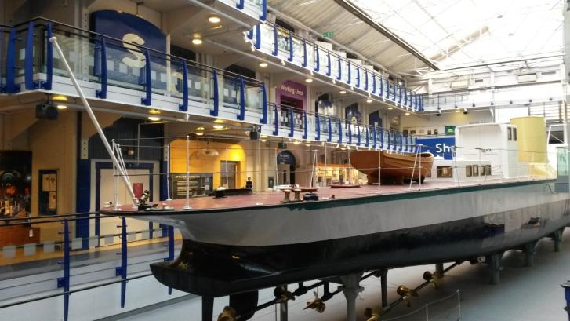
A Visual Guide to Discovery Museum

Slide 2
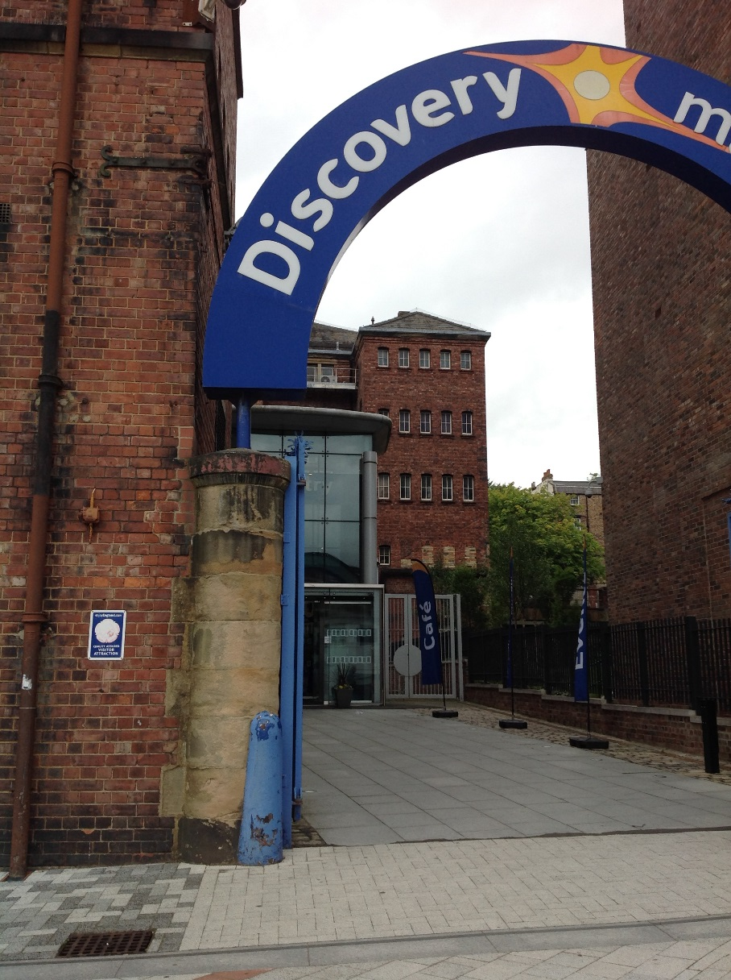
The outside of the Discovery Museum looks like this. The entrance is signposted. When you walk up to the museum the automatic doors will open for you.

Slide 3
The Plaza
In front of the museum is the plaza. Sometimes we have events on here.
Can you spot the Challenger Tank?

Slide 4
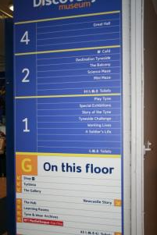
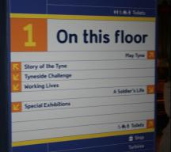
Navigating your way around the museum
There are lots of maps and signs to help you find what you are looking for on each floor.
If you are still lost there are plenty of people to ask. You can find them here.

Slide 5
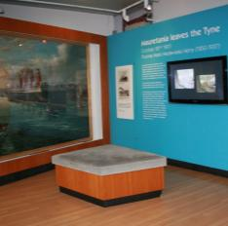
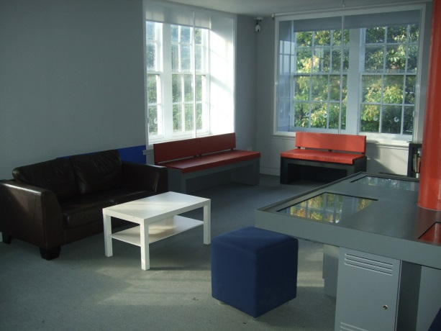
Places to relax……..
There are plenty of seats around the museum in quieter areas inside and outside the exhibitions on all floors.
Ground floor
First floor
Second floor

Slide 6
Ground Floor

Slide 7
Welcome Desk and Trails
Our friendly Front of House team will greet you upon arrival and depending on your preference let you head off straight away to explore or talk to you about where to find things and provide helpful hints for enjoying your visit. Here you can also collect a explorers trail. Occasionally, low-cost trails are available to buy from the shop with a prize draw incentive.

Slide 8
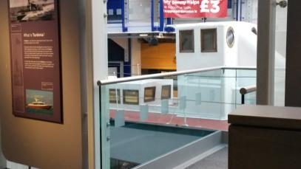
The Turbinia
Unfortunately you cannot go on Turbinia but there is a viewing platform.

Slide 9
The Shop
As you enter the museum you will pass the shop selling a range of fun objects from science kits to ships, posters to pencils!

Slide 10
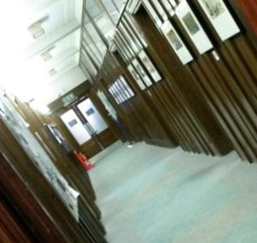
The Archives
Based in Discovery Museum Tyne & Wear Archives is home to thousands of documents relating to the five local districts of Newcastle, Sunderland, Gateshead, North Tyneside and South Tyneside.
Visiting the archives is currently by pre-booked appointment only.

Slide 11
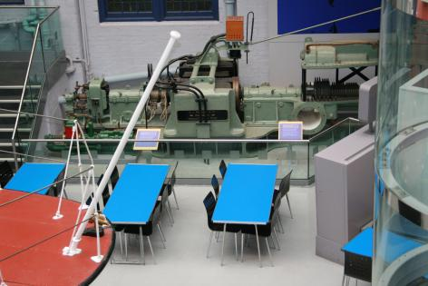
Packed Lunch Space
This is the area to use in the museum if you want to bring a packed lunch. This is next to Turbinia.

Slide 12
Buggy Park and Water Station
In this area, near Thomas the Tank engine, you can refill water bottles and park Buggies whilst you explore the museum. Please take valuables with you as this area is unsupervised. Lockers are available for £1 (non-returnable).

Slide 13
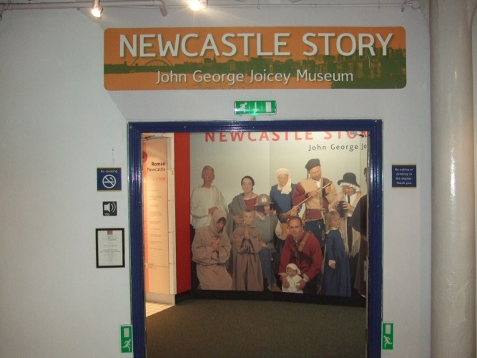
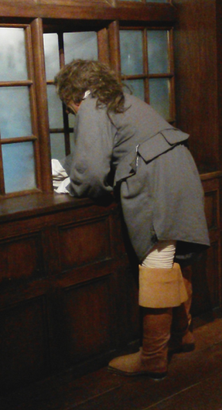
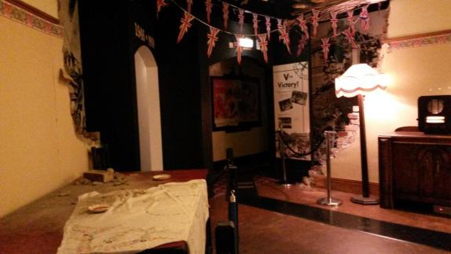
Newcastle Story
Walk the streets of Newcastle through the years, from Roman times to the year 2000.
There are many different familiar and unusual sounds in this exhibition from talking to music. It can be quite loud in places so may not be suitable for all visitors.
A siren goes off in the 1940s house bombed during an air raid.
Watch out for the man shouting out the window.

Slide 14
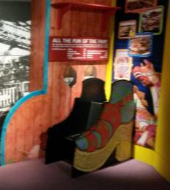
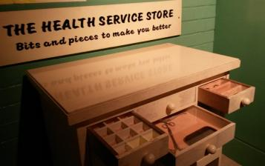
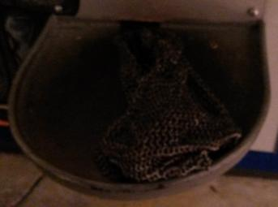
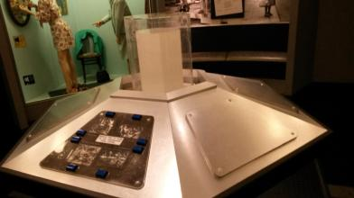
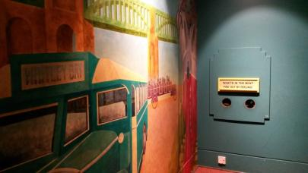
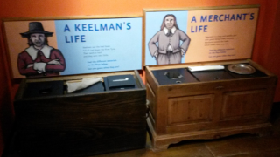
Newcastle Story
These are just some of the things that you can touch and explore.

Slide 15
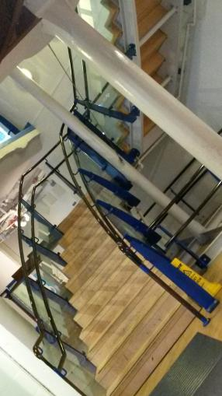
You can take the stairs or catch the lift to first and second floor

Slide 16
First floor

Slide 17
Charge Over 200 years of life in the army
This gallery contains collections and stories from England’s Northern Cavalry. Watch out for the loud soldier interactive giving commands.

Slide 18
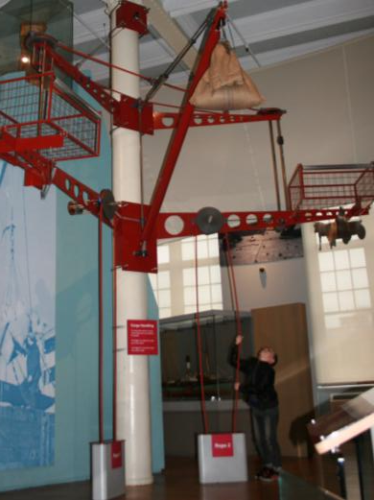
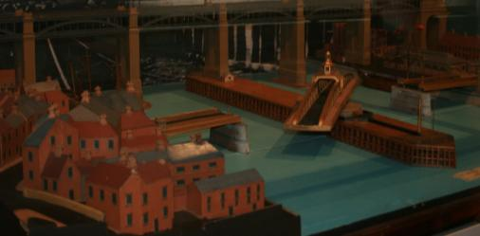
Story of the Tyne
This gallery highlights some of the key industries that scatter the shores of the Tyne, including full size boats, a ship model wall and a model of the river as it flows from its source. There is lots to see and do!
Interactives include a swing bridge and a pully.

Slide 19
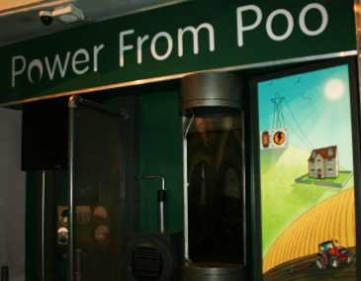
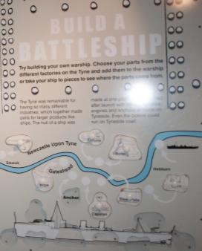
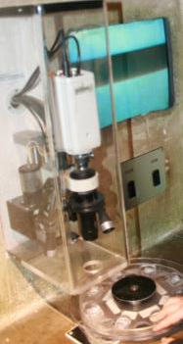
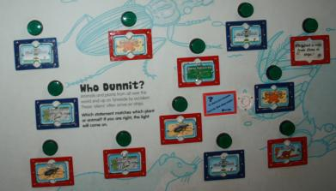
Story of the Tyne
These are just some of the things to touch and explore in Story of the Tyne.

Slide 20
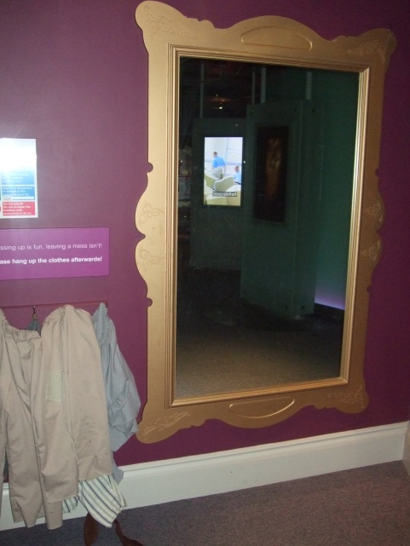
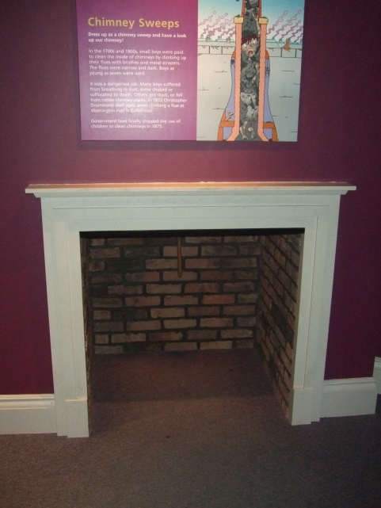
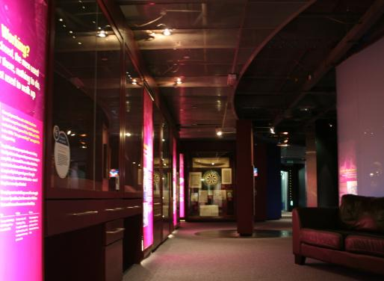
Working Lives
Learn about the experiences of people working and living on Tyneside.
The lighting is dim in this gallery.
In this doorway you can watch some videos. It can be loud and is dark.
Experience the life of a chimney sweep. Dress up and climb up the chimney!

Slide 21
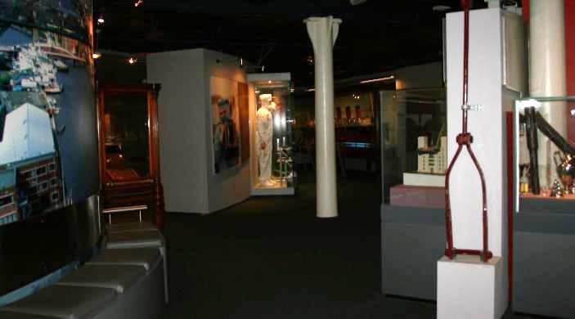
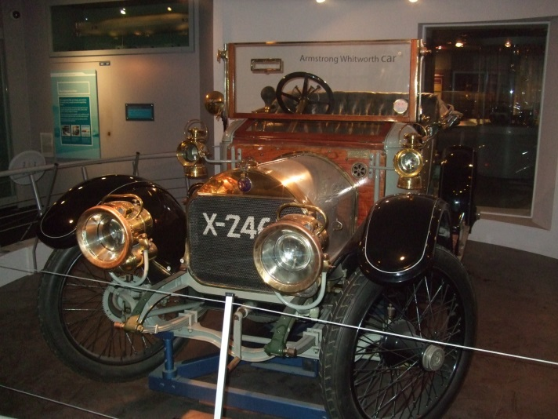
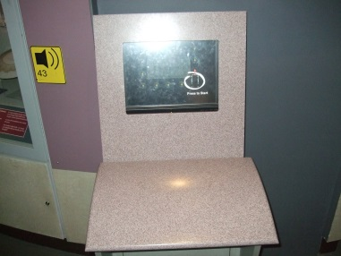
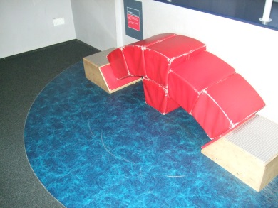
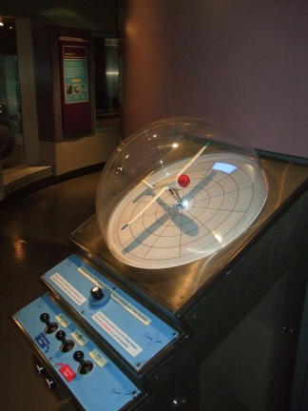
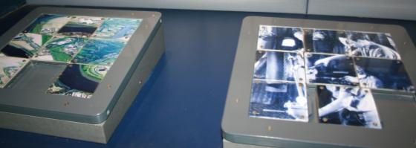
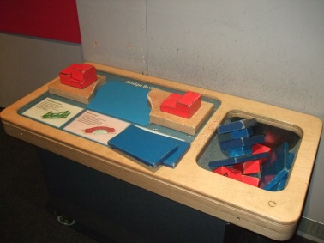
Tyneside Challenge
See some of the most important and interesting inventions made on Tyneside, from Stephenson's famous locomotives to the revolutionary Armstrong No.1 Gun.
This gallery is quite dim.
There are lots of hands on activities.

Slide 22
Second Floor

Slide 23
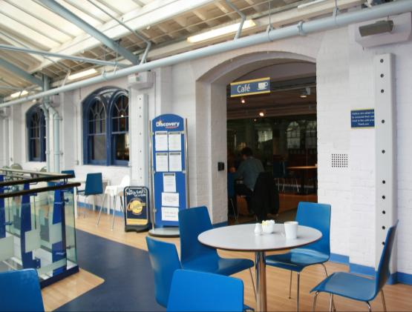
Café
A selection of hot and cold drinks, meals, sandwiches and cakes are available.
There is a range of seating from Sofas, tub chairs and high chairs for our younger visitors.

Slide 24
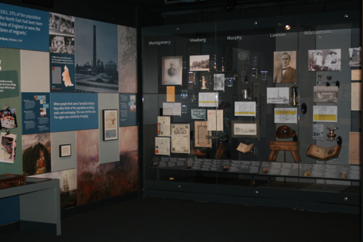
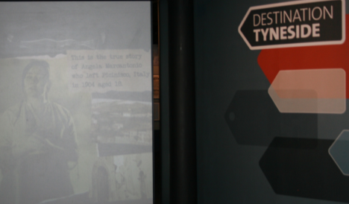
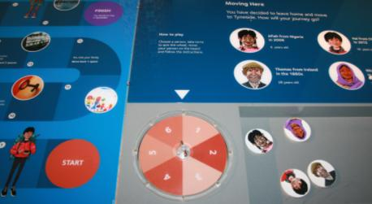
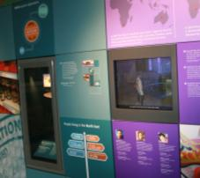
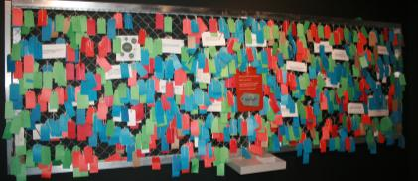
Destination Tyneside
Destination Tyneside tells the story of people who have migrated to the North East and who have made Tyneside their home.
This exhibition combines moving image with games and activities. You can even research the lives of some of the migrants to Tyneside, using online websites .

Slide 25
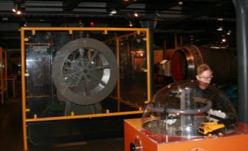
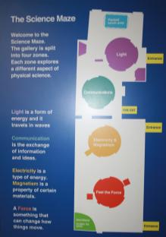
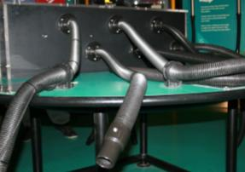
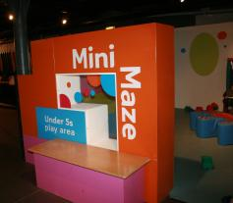
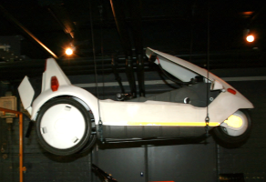
Science Maze
A noisy, interactive space exploring sound, light, forces and electricity.
A huge variety of interactive displays bring science and engineering to life, with favourites including the shadow wall and the air hockey table.
Under 5s play area.
A guide at the entrance helps you to navigate.

Slide 26
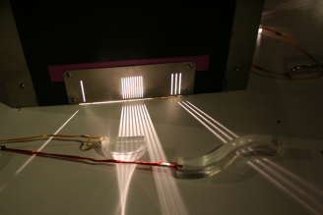
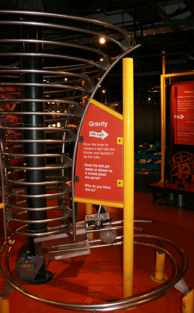
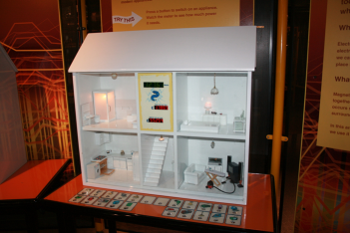
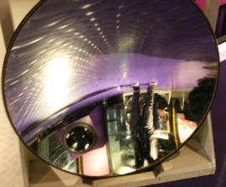
More Science Maze interactives
There are lots of hands on activities.

Slide 27
PLAY + INVENT
At the back of Science Maze is our PLAY+INVENT space.
In here you can take part in make and create crafts which take place on specific dates during school holidays.
Sometimes it costs to use this space, so check our website before you come along.

Slide 28
See you soon…..
More information available from
https://discoverymuseum.org.uk/visit-us/access-information
https://discoverymuseum.org.uk/visit-us
https://discoverymuseum.org.uk/learning/essential-information
If you have any questions or require any further information before you visit the museum then please get in touch with a member of the learning team via email learning@discoverymuseum.org.uk or ring 0191 277 2183
Visit https://www.google.com/culturalinstitute/collection/discovery-museum for Street View access to the Museum.

