Slide 1


Morse Code

Slide 2
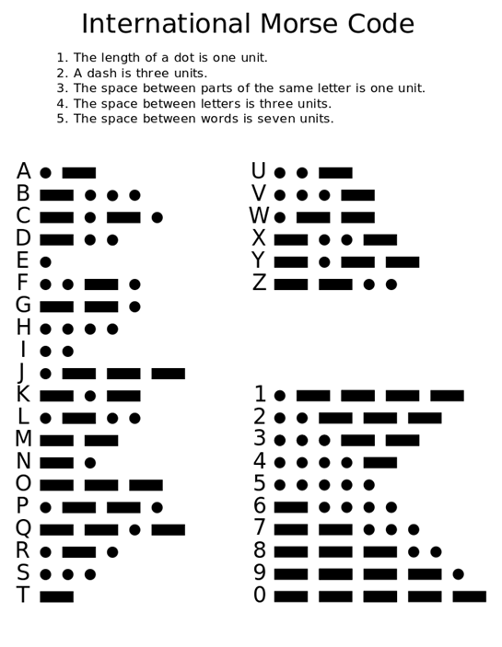

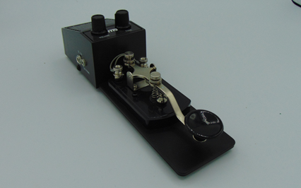
What is the word?
A dot sounds like
A dash sounds like
Fast
Slower
Letter 1
Letter 2
Letter 3
Letter 4
Letter 5

